Slide 1
Cover

Slide 2



The Postal Museum Learning resource Terms of Use
By downloading this PowerPoint and using these images you agree to The Postal Museum and Royal Mail Group Ltd terms of use.
The material in this PowerPoint is provided for non-commercial and educational use in your classroom.
You can use the presentation or individual images in lessons and activities, and print out the images for use in your classroom.
You can share the presentation with other teachers for non-commercial and educational use in their classrooms.
Image credits must be included wherever the image is used. These are below each image, e.g. ©The Postal Museum 2010-0423/2
Non-The Postal Museum material is included at the agreement of the copyright holder and must also be credited, e.g. ©Courtesy of BT heritage and archives

Slide 3
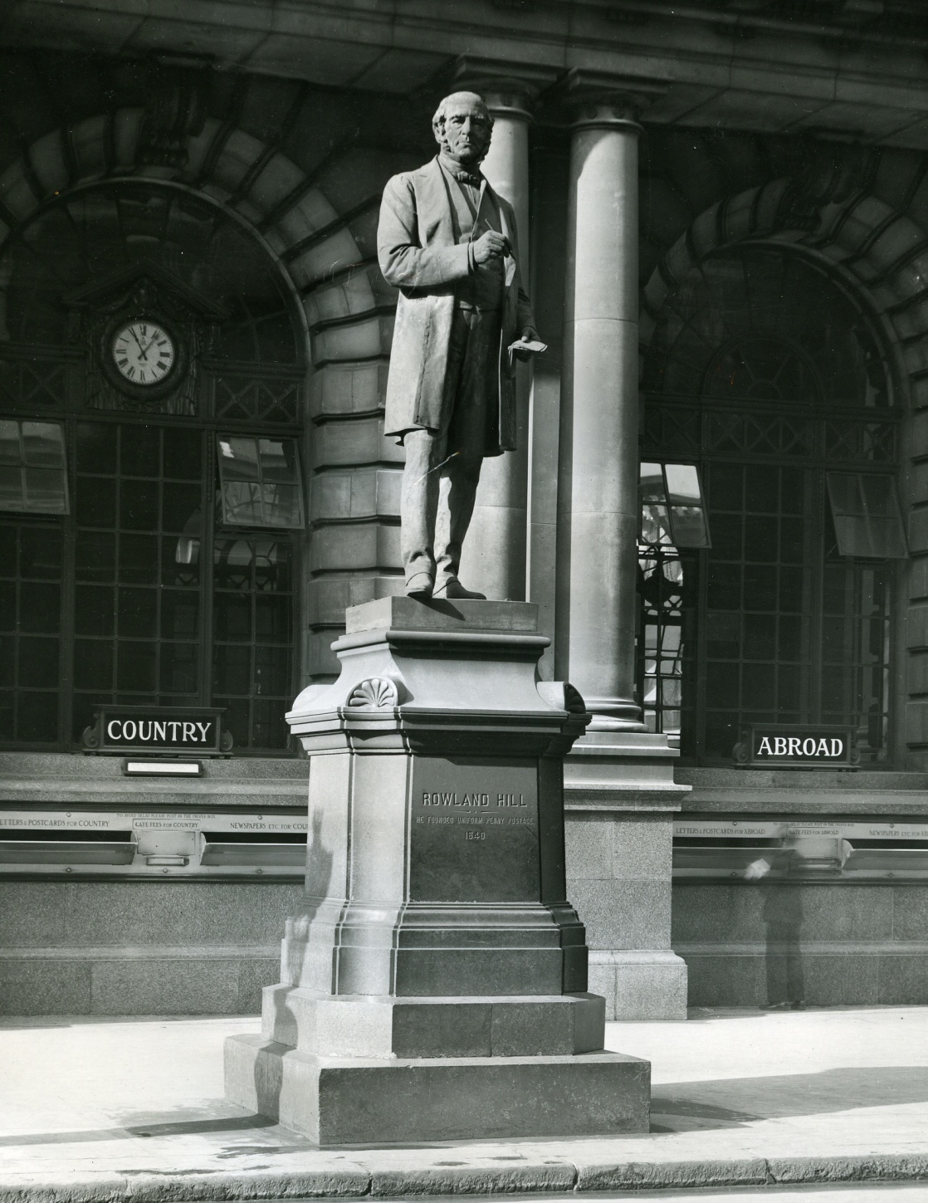
©Royal Mail Group 2015, courtesy of The Postal Museum
Statue of Rowland Hill outside the former General Post Office headquarters in London.

Slide 4
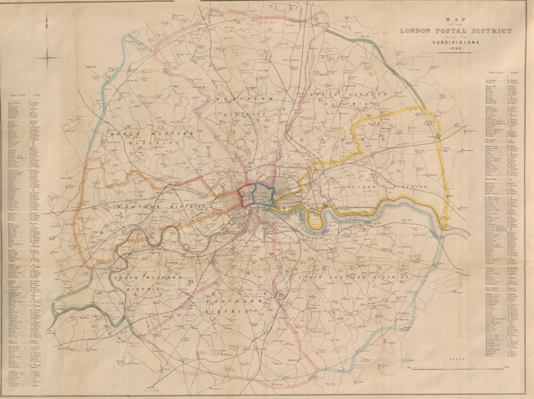
©Royal Mail Group Ltd, 2015, courtesy of The Postal Museum
Map of London postal districts, 1856

Slide 5
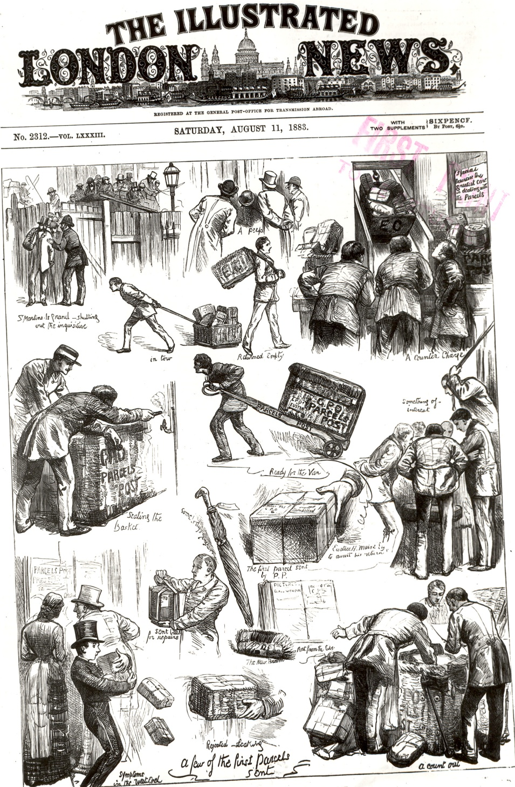
©Royal Mail Group Ltd, 2015, courtesy of The Postal Museum POST 118/1336
1883 illustration from The London Illustrated News satirising the introduction of Parcels Post

Slide 6
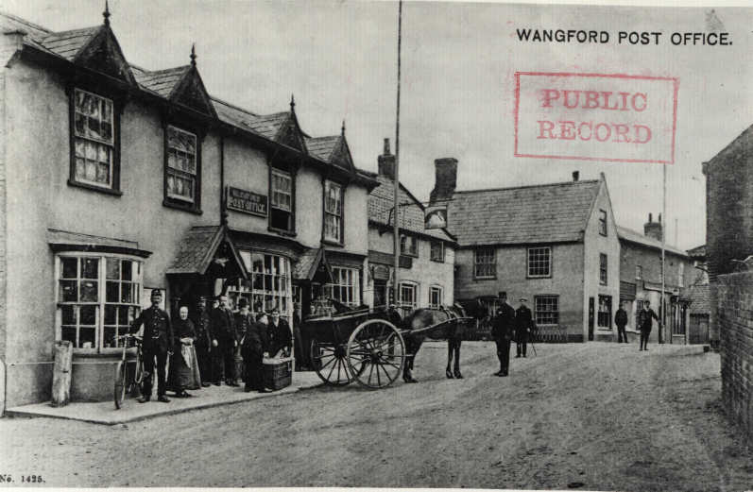
©Royal Mail Group Ltd, 2015, courtesy of The Postal Museum
Wangford Post Office, c.1900 with horse drawn van outside

Slide 7
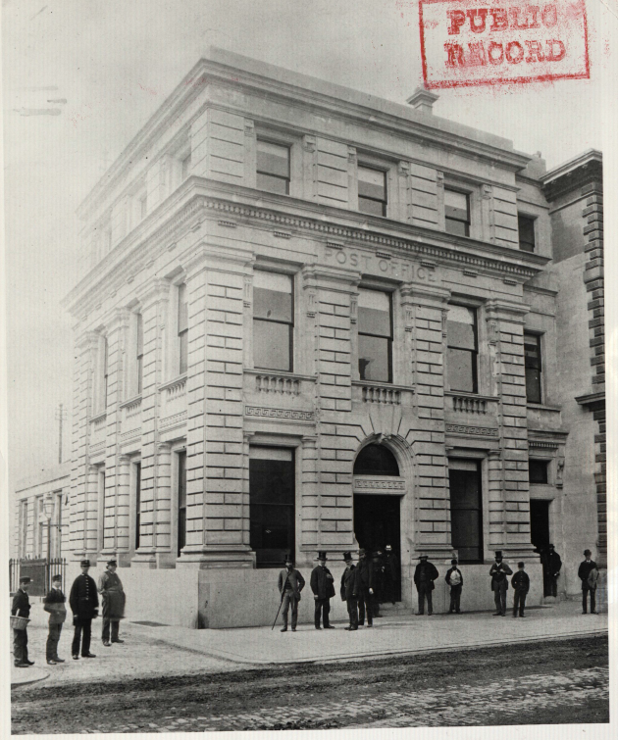
©Royal Mail Group Ltd, 2015, courtesy of The Postal Museum
Cardiff Post Office built in 1886. Post Offices were often very grand buildings.

Slide 8
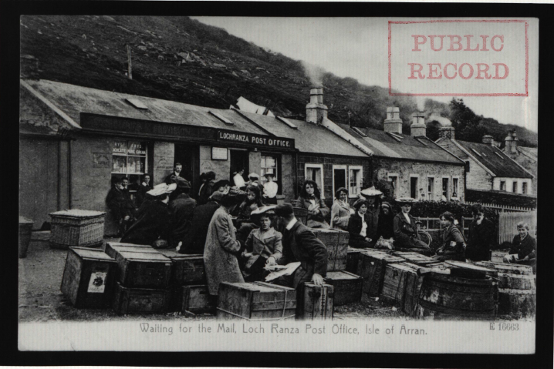
©Royal Mail Group Ltd, 2015, courtesy of The Postal Museum
Post Offices opened in remote places. This is Loch Ranza, Isle of Arran c.1900

Slide 9
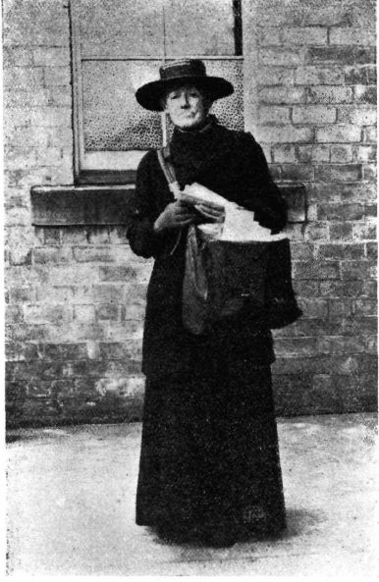
©Royal Mail Group Ltd, 2015, courtesy of The Postal Museum, St Martin’s Le Grand, POST 92 1909
Elizabeth Dickson walked thirteen and a half miles a day. In her career this was equal to more than five times round the world!

Slide 10
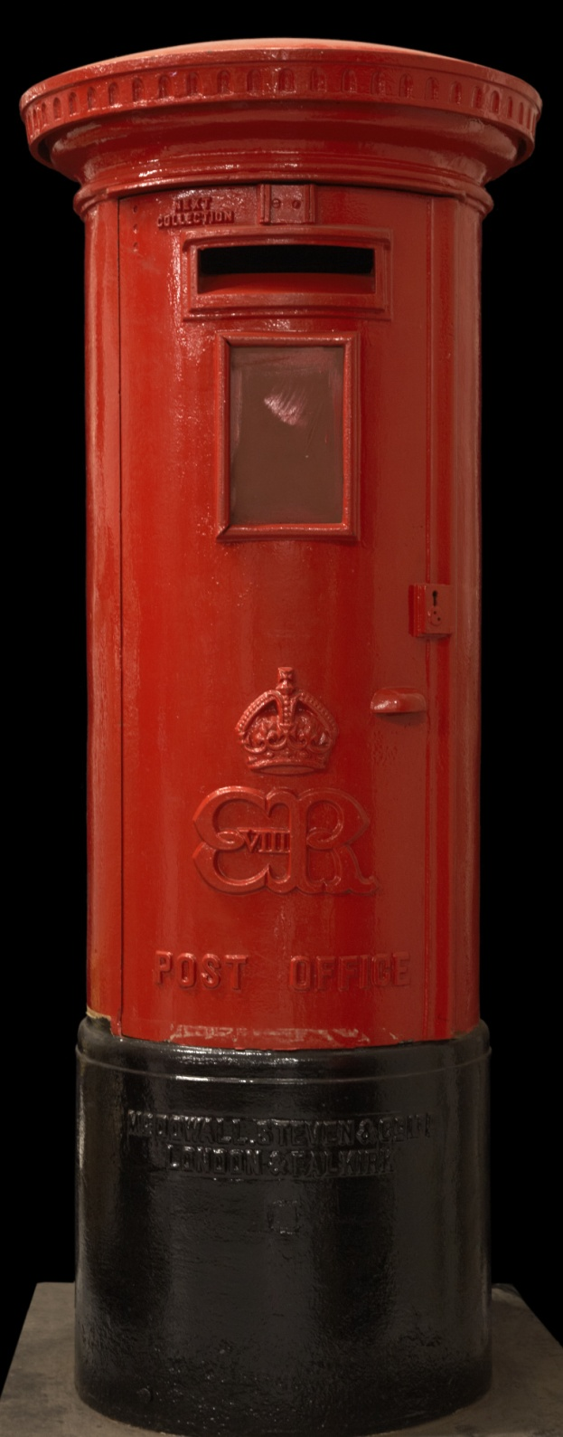
©The Postal Museum, 0B1994.45
Post boxes with the Edward VIII cipher are very rare because he was king for less than a year in 1936 and was never crowned.

Slide 11
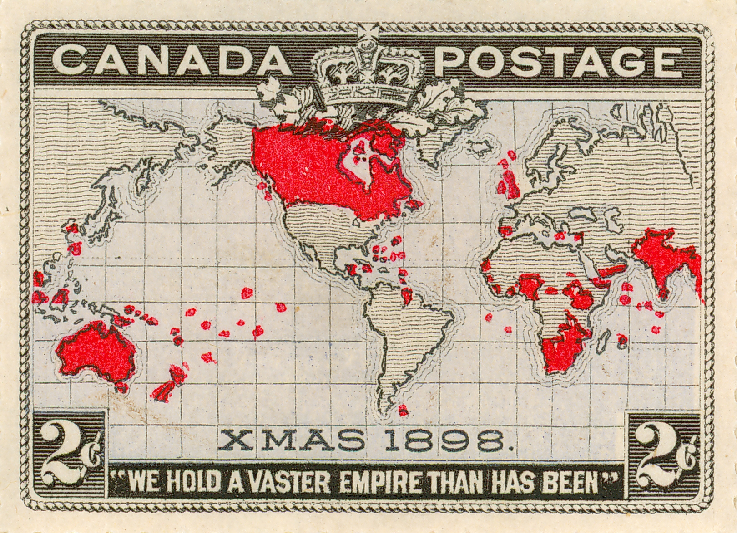
©Royal Mail Group 2015, courtesy of The Postal Museum
An early Canadian stamp , 1898

Slide 12
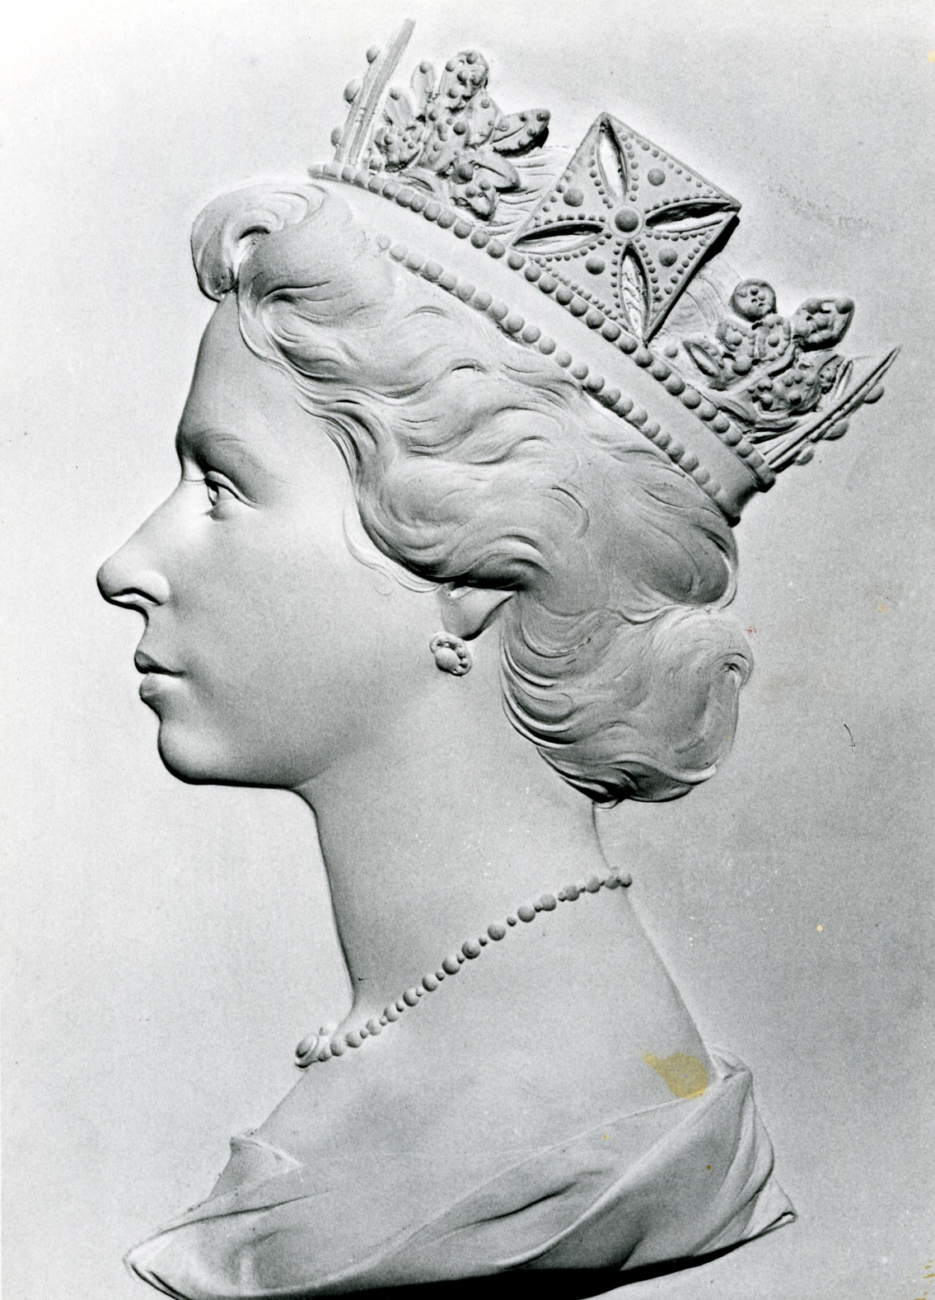
©Royal Mail Group 2015, courtesy of The Postal Museum POST 118/5373
This plaster head of Queen Victoria II was made by Arnold Machin and is used on definitive stamps today

Slide 13
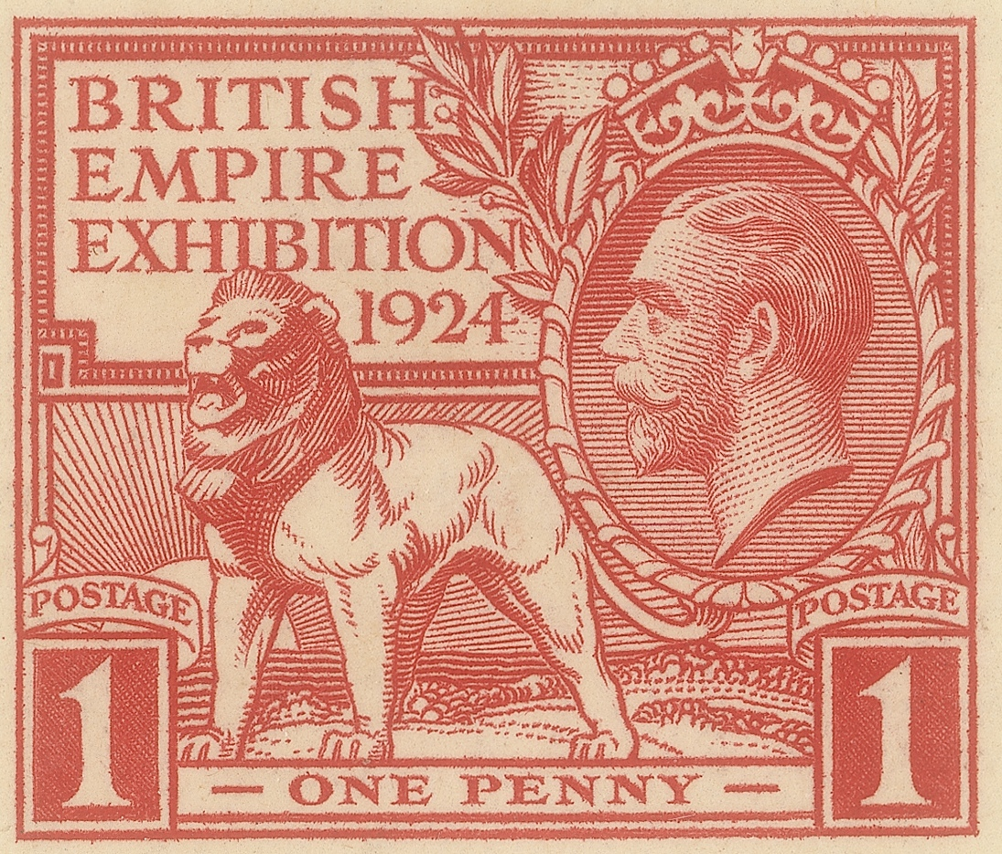
©Royal Mail Group 2015, courtesy of The Postal Museum
The first commemorative stamp was issued in 1924 to mark the British Empire exhibition.

Slide 14
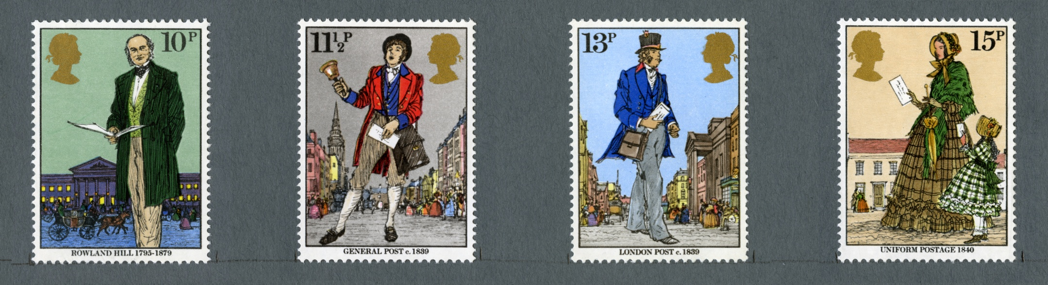
©Royal Mail Group 2015, courtesy of The Postal Museum
Rowland Hill and his postal reforms have been commemorated on several commemorative postage stamps.

Slide 15
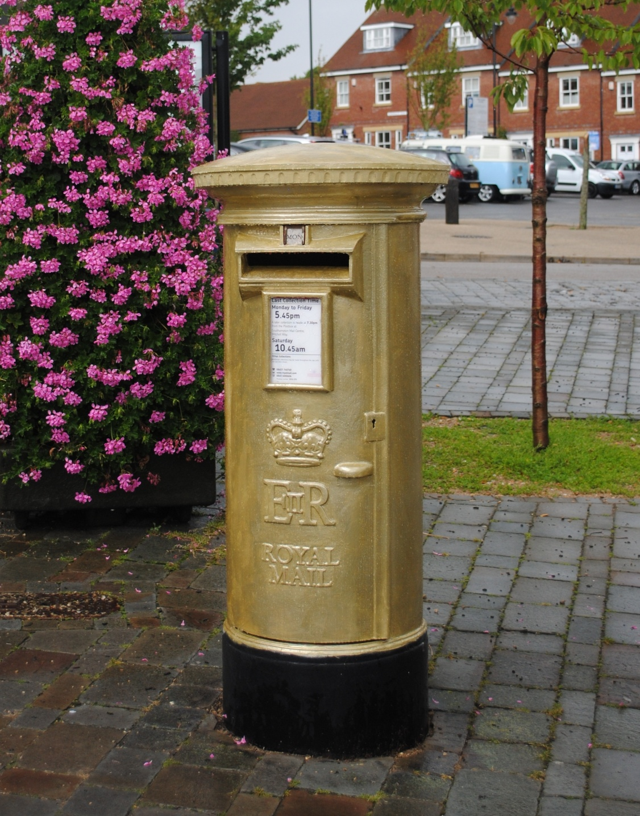
©Royal Mail Group 2015, courtesy of The Postal Museum
Rowland Hill and his postal reforms have been commemorated on several issues of postage stamps.

