Slide 1
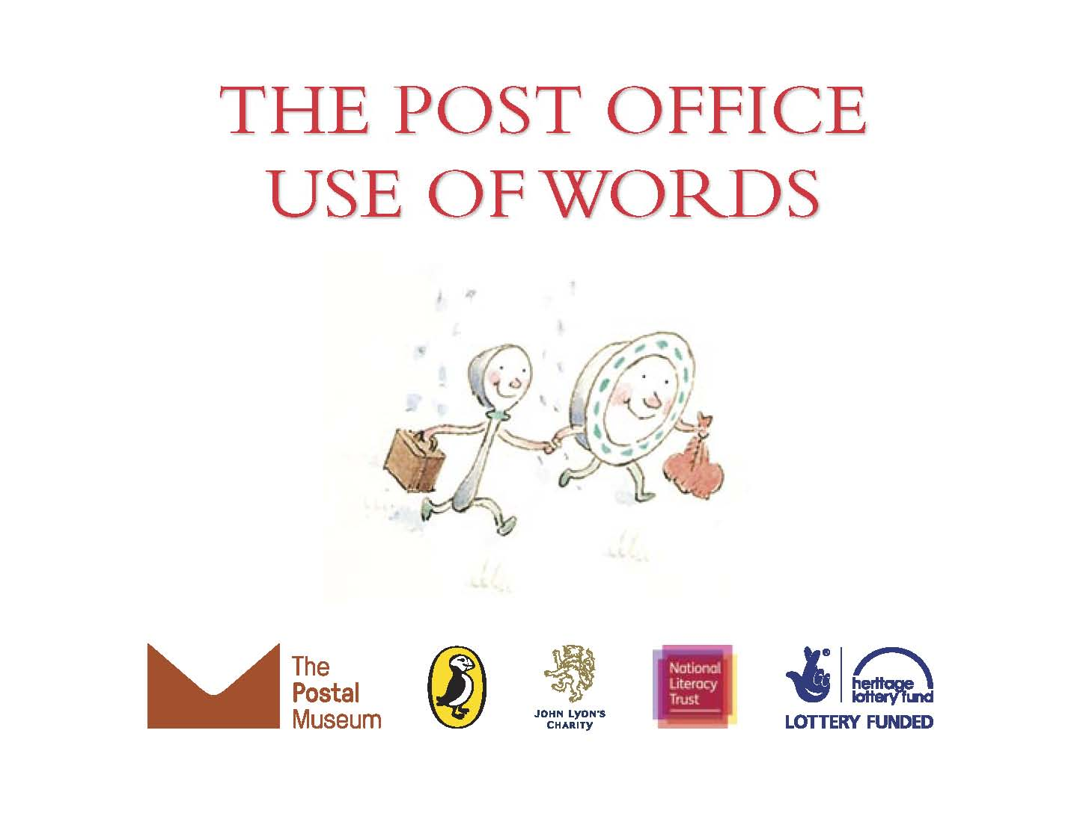

Slide 2




The Postal Museum Learning Resource
Terms of Use
By downloading this PowerPoint and using these images you agree to The Postal Museum (TPM) terms of use.
The material in this PowerPoint is provided for non-commercial and educational use in your classroom.
You can use the presentation or individual images in lessons and activities, and print out the images for use in your classroom.
You can share this presentation with other teachers for non-commercial and educational use in their classrooms.
Image credits must be included wherever the image is used. These are below each image, e.g. ©The Postal Museum 2010-0432/2
Non-The Postal Museum material is included at the agreement of the copyright holder and must also be credited, e.g. ©Courtesy of BT heritage and archives

Slide 3
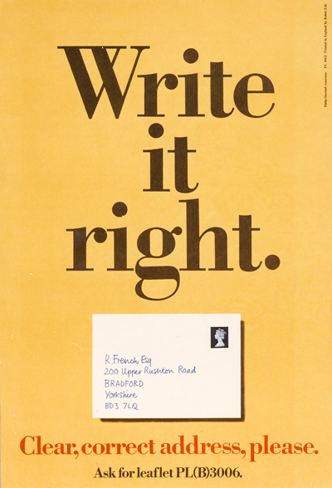
©Royal Mail Group Ltd, courtesy of The Postal Museum, POST 110/0209
Notes:
©Royal Mail Group Ltd, courtesy of The Postal Museum, POST 110/0209
This poster from the 1970s plays on the rhyming words ‘write’ and ‘right’. It promotes a leaflet giving advice on how to write the correct postal address. People could find the leaflet in their local Post Office

Slide 4
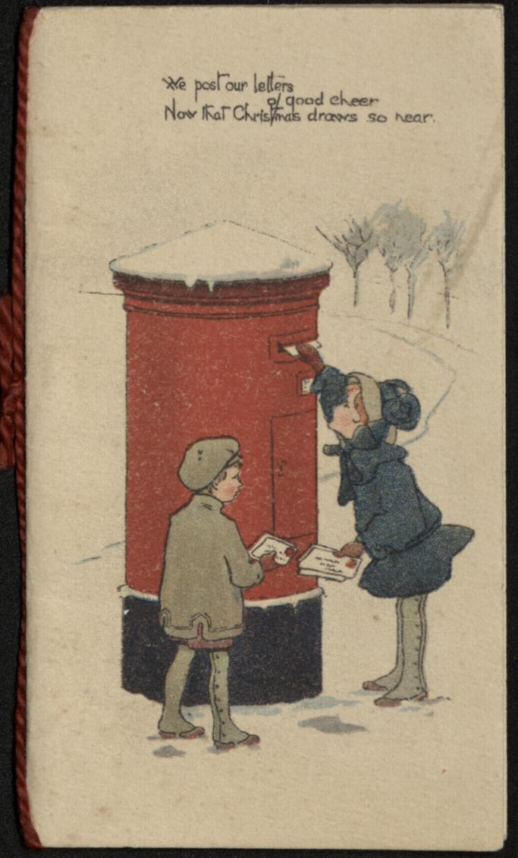
©The Postal Museum, 2005-0101/2
Notes:
©The Postal Museum, 2005-0101/2
This Christmas card from the early 20th century shows young children posting cards into a post box with snow on the dome. Post boxes are a very popular image on Christmas cards. The message on the front of the card rhymes ‘cheer’ and ‘near’.

Slide 5
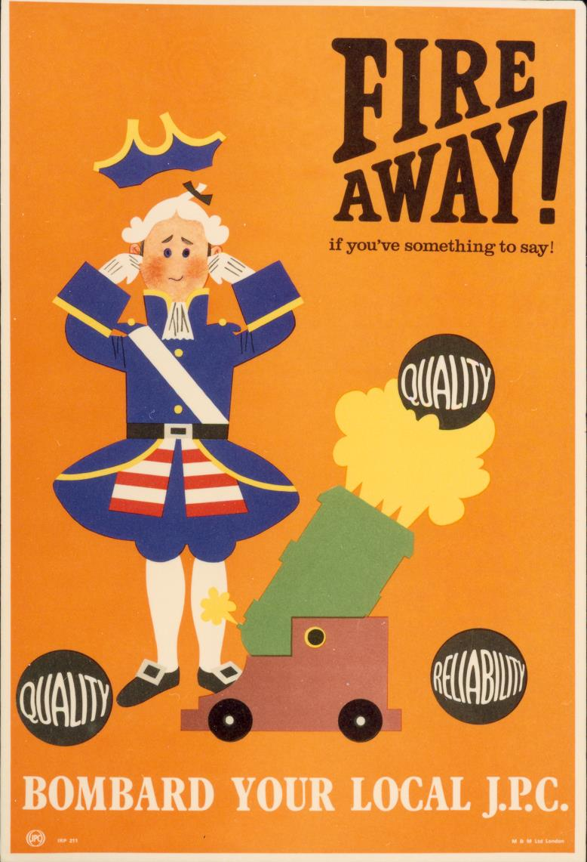
©Royal Mail Group Ltd, courtesy of The Postal Museum
Notes:
©Royal Mail Group Ltd, courtesy of The Postal Museum
This poster uses rhyme and plays on the word ‘fire’ with a canon illustration.

Slide 6

©Royal Mail Group Ltd, courtesy of The Postal Museum
Notes:
©Royal Mail Group Ltd, courtesy of The Postal Museum
This poster for the Post Office Savings Bank uses word play to encourage parents to save for their children’s future.

Slide 7
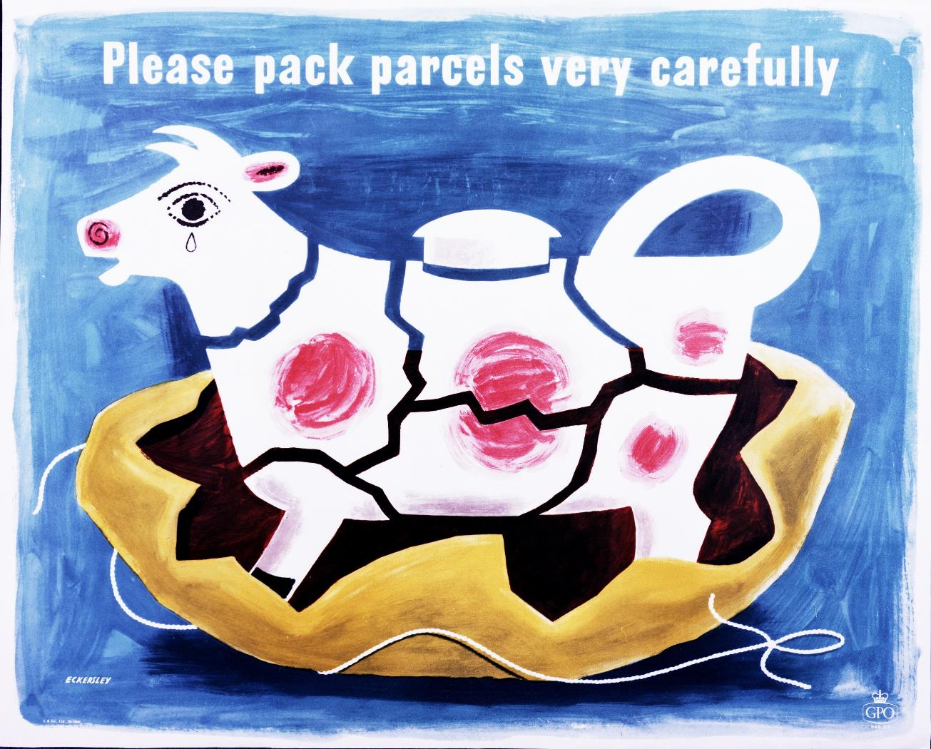
©Royal Mail Group Ltd, courtesy of The Postal Museum, POST 110/2598
Notes:
©Royal Mail Group Ltd, courtesy of The Postal Museum, POST 110/2598
This poster uses alliteration to encourage people to pack their parcels carefully. The image is of a broken teapot in the shape of a cow. The poster is designed by Tom Eckersley, a famous designer in the 20th century.

Slide 8
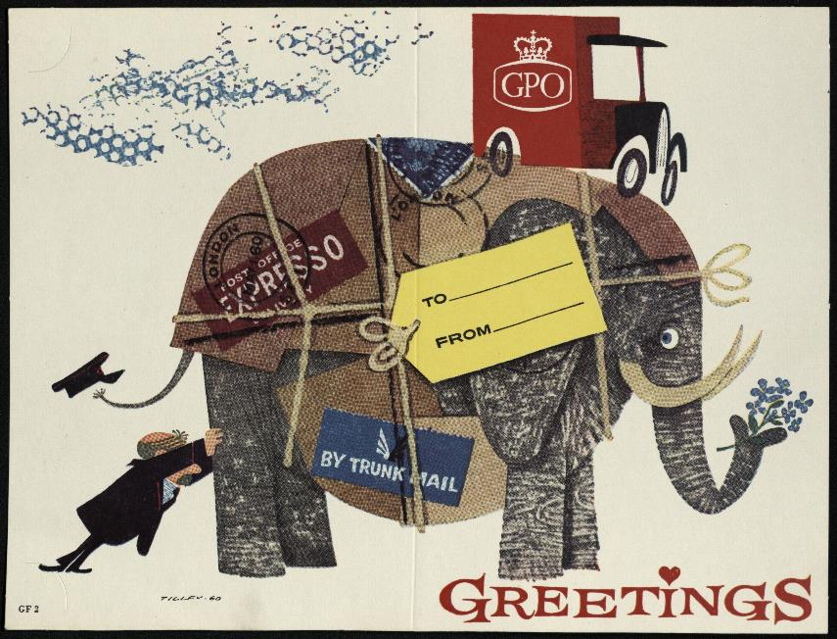
©Royal Mail Group Ltd, courtesy of The Postal Museum, POST 122/15125
Notes:
©Royal Mail Group Ltd, courtesy of The Postal Museum, POST 122/15125
This sample artwork for a specimen Christmas card dates from 1960s and uses a cartoon elephant to promote posting by ‘trunk mail’.

Slide 9
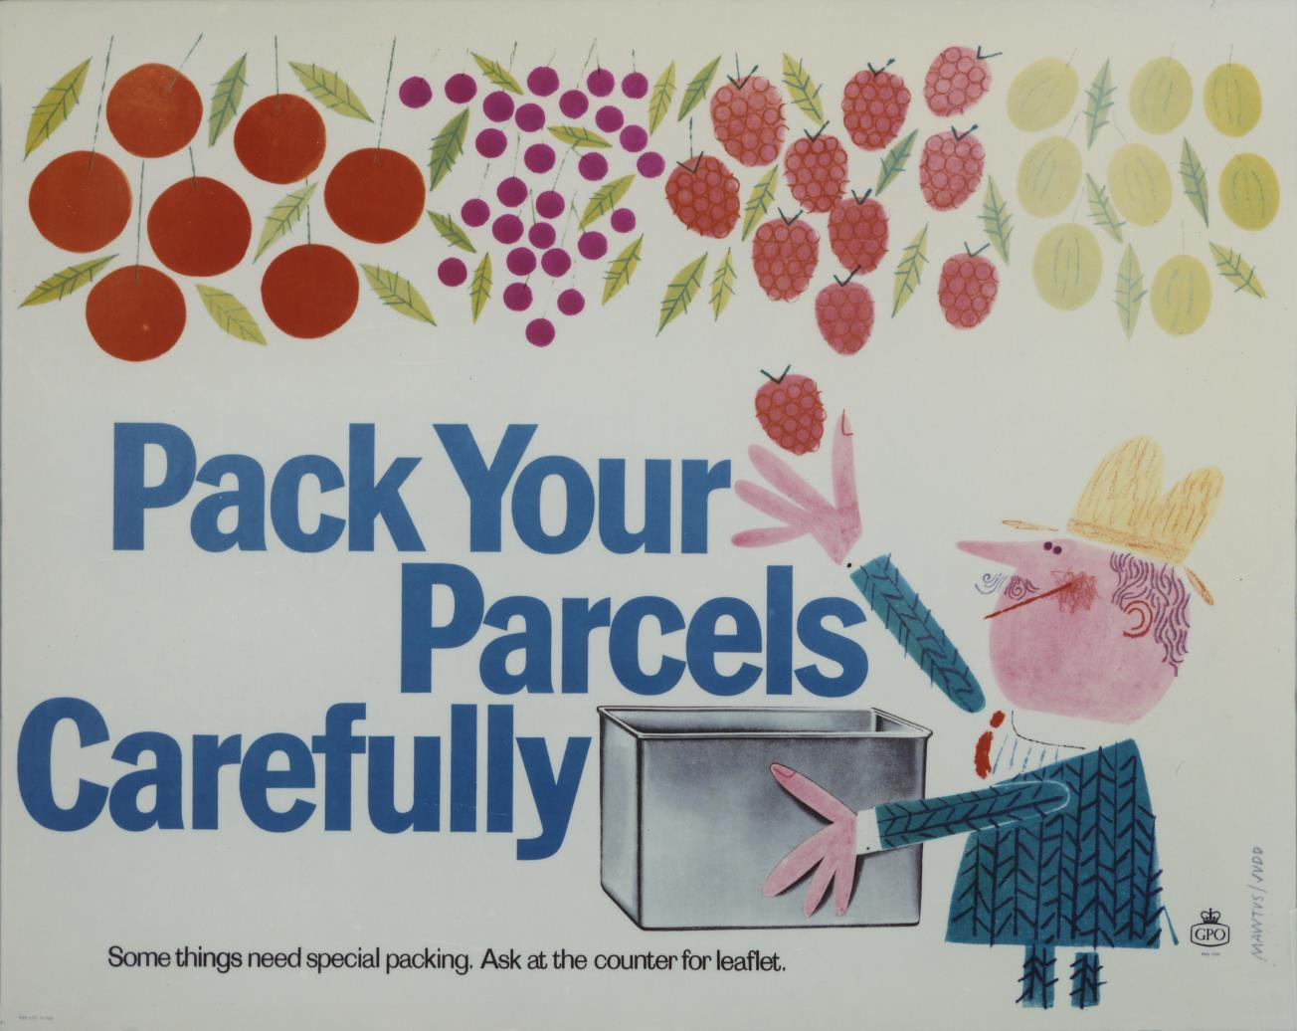
©Royal Mail Group Ltd, courtesy of The Postal Museum, POST 110/2625
Notes:
©Royal Mail Group Ltd, courtesy of The Postal Museum, POST 110/2625
This poster use alliteration and word play and shows a man putting fruit into a box. You can pick up special leaflets at the Post Office to tell you how to pack parcels carefully. This is very important for food items and items that can break.

Slide 10
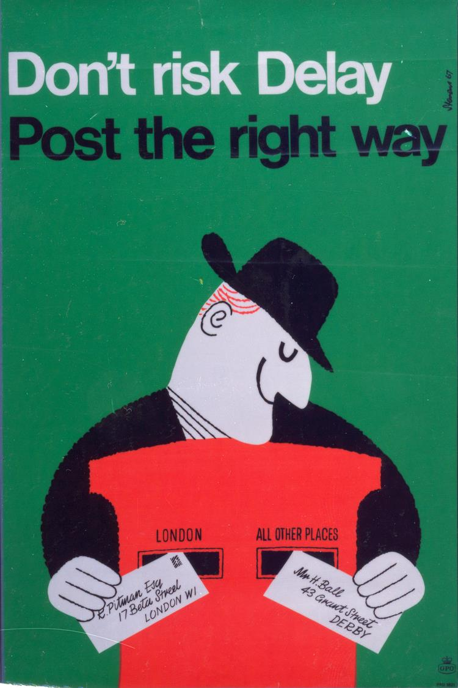
©Royal Mail Group Ltd, courtesy of The Postal Museum, POST 110/2655
Notes:
©Royal Mail Group Ltd, courtesy of The Postal Museum, POST 110/2655
This poster tells people to make sure they are posting their letters in the right box. It rhymes the word ‘Delay’ and ‘Way’.

