Slide 1


Slide 2




The Postal Museum Learning Resource
Terms of Use
By downloading this PowerPoint and using these images you agree to The Postal Museum (TPM) and Royal Mail Group Ltd terms of use.
The material in this PowerPoint is provided for non-commercial and educational use in your classroom.
You can use the presentation or individual images in lessons and activities, and print out the images for use in your classroom.
You can share this presentation with other teachers for non-commercial and educational use in their classrooms.
Image credits must be included wherever the image is used. These are below each image, e.g. ©The Postal Museum 2010-0432/2
Non-The Postal Museum material is included at the agreement of the copyright holder and must also be credited, e.g. ©Courtesy of BT heritage and archives

Slide 3
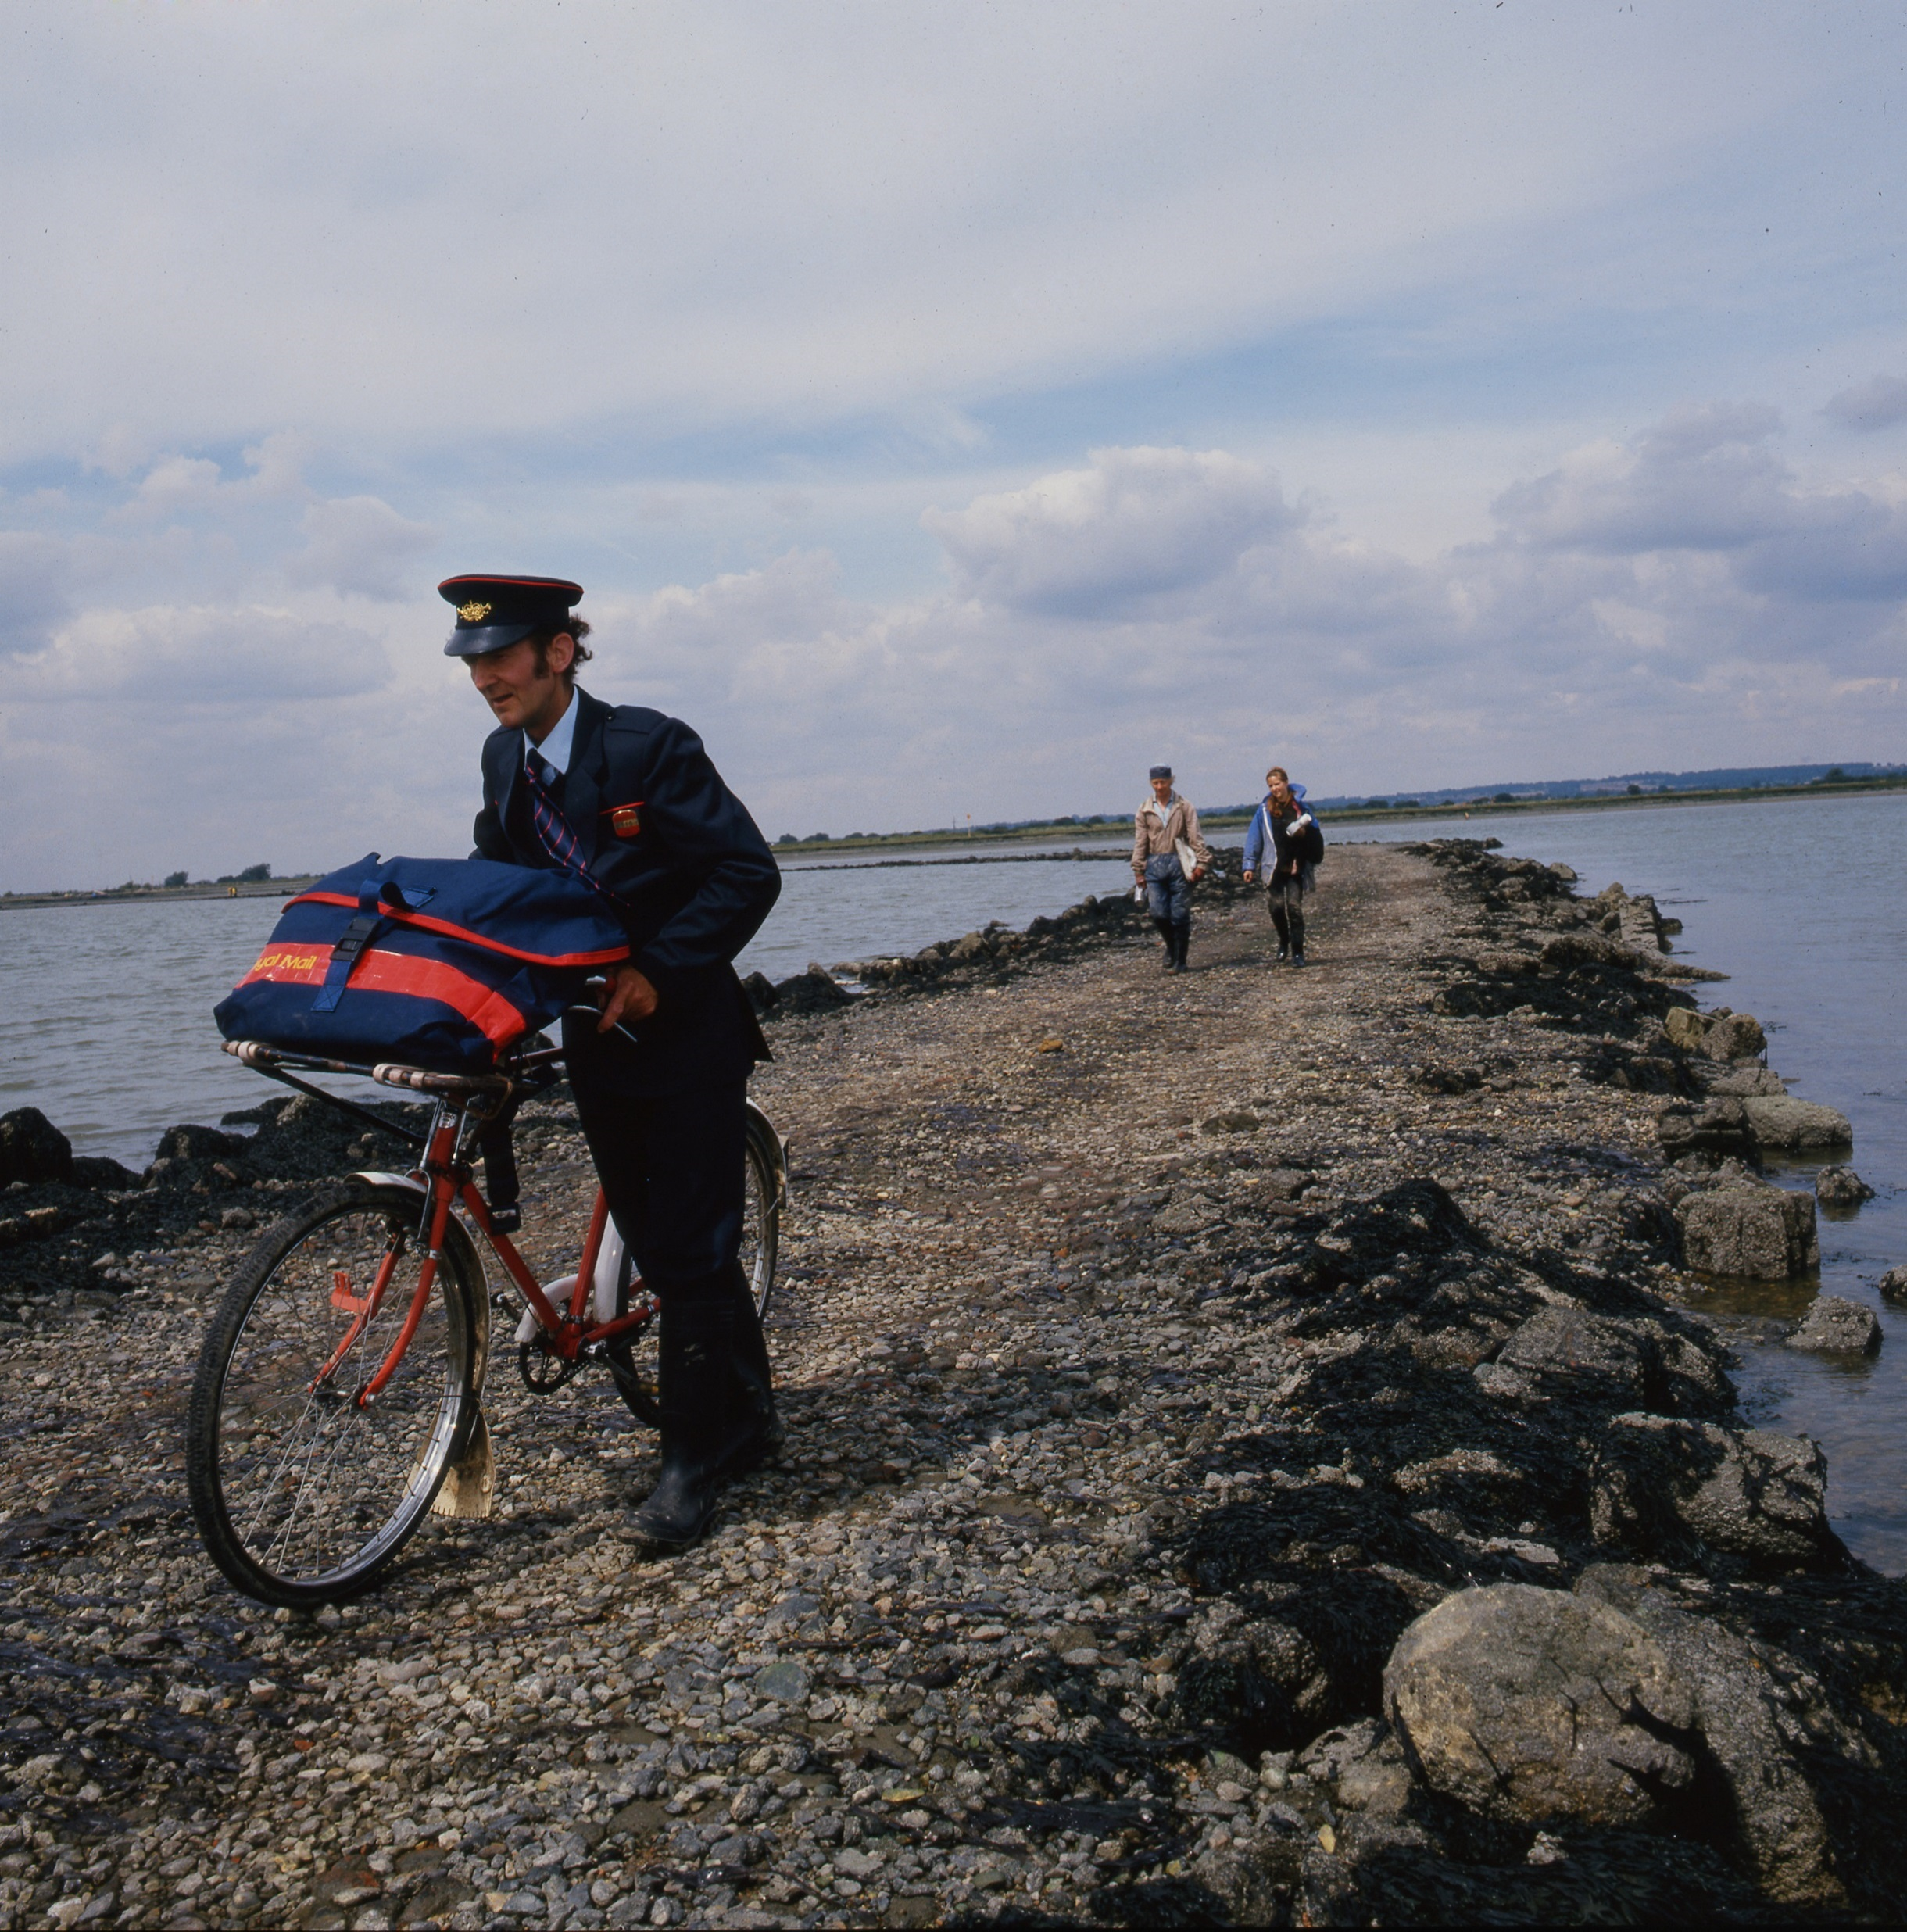
©Royal Mail Group Ltd, courtesy of The Postal Museum
Notes:
©Royal Mail Group Ltd, courtesy of The Postal Museum
Postman Ken Chaplin pushes his bicycle across a causeway to Osea Island, near Maldon, Essex. The rough slippery causeway led Ken to fit double tyres to his red bicycle.

Slide 4

©Royal Mail Group Ltd, courtesy of The Postal Museum
Notes:
©Royal Mail Group Ltd, courtesy of The Postal Museum
Postman John Rooney rowing across Lough Erne in Ulster. John delivered mail to people on remote islands.

Slide 5
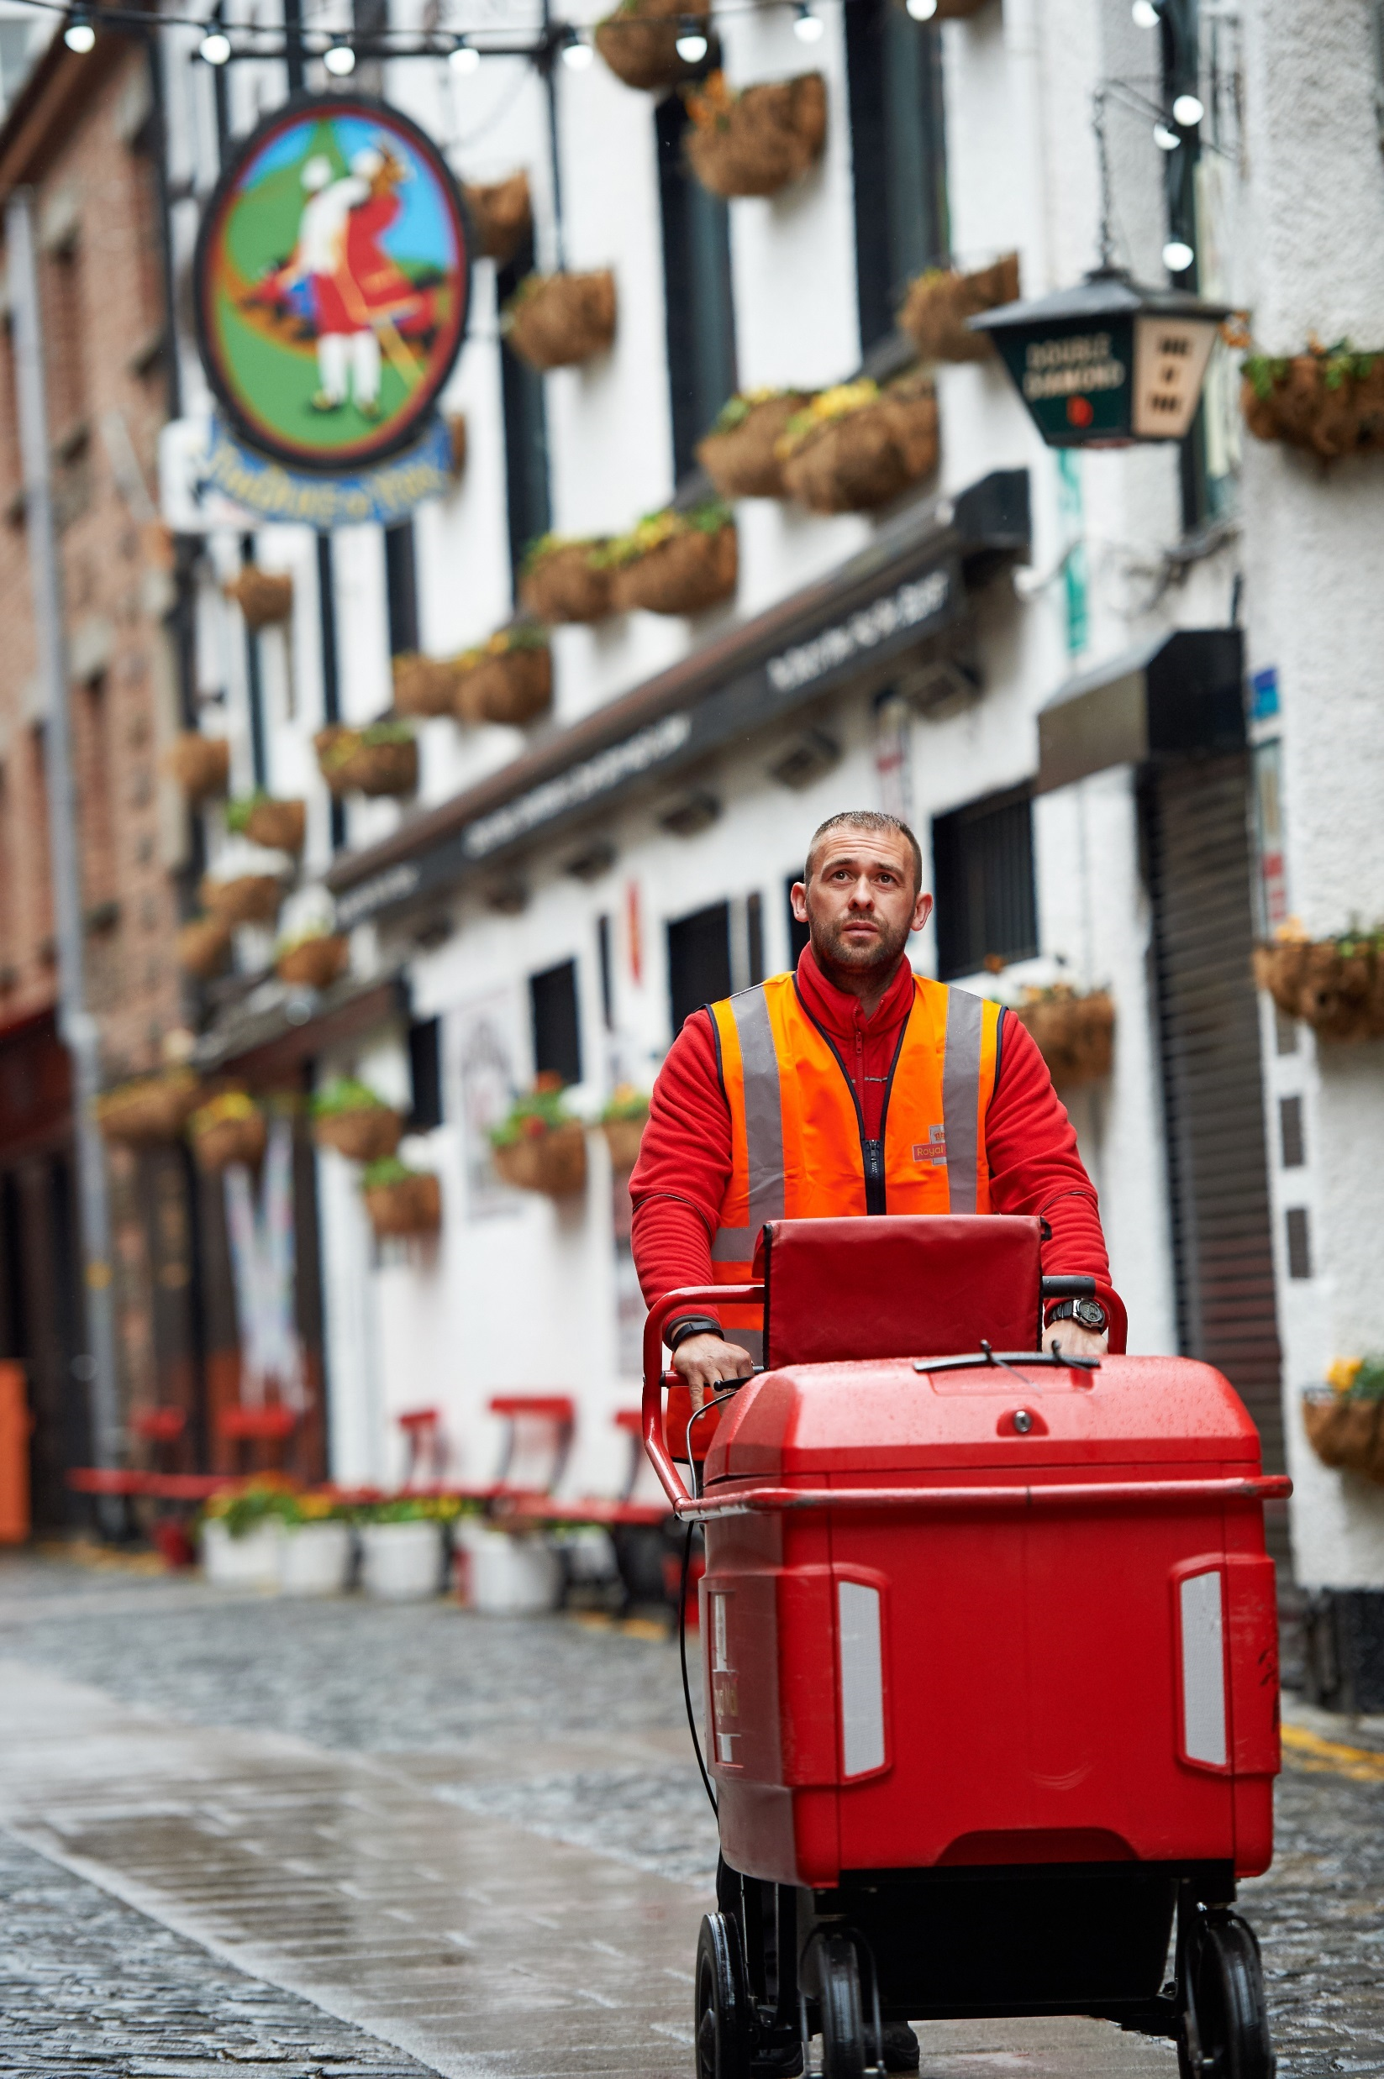
©Royal Mail Group Ltd
Notes:
©Royal Mail Group Ltd
This postie pushes his delivery trolley through the historic city of York.

Slide 6
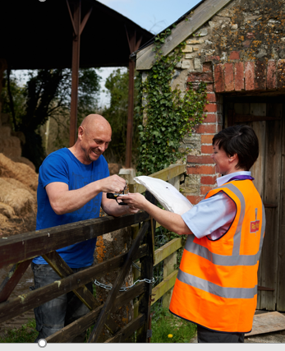
©Royal Mail Group Ltd
Notes:
©Royal Mail Group Ltd
This post lady delivers the post to a rural farm.

Slide 7
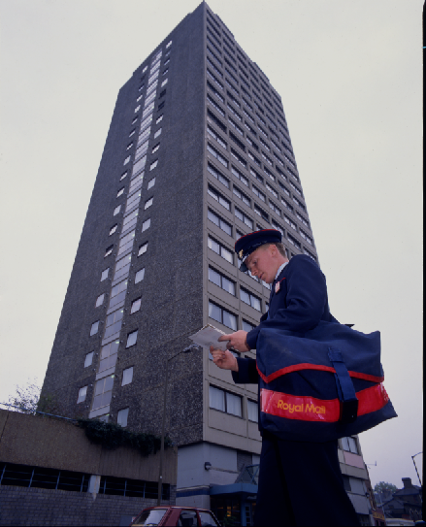
©Royal Mail Group, courtesy of The Postal Museum
Notes:
©Royal Mail Group, courtesy of The Postal Museum
Postman Jamie Long sorts out his delivery to flats in Battersea, London in 1980s.

Slide 8
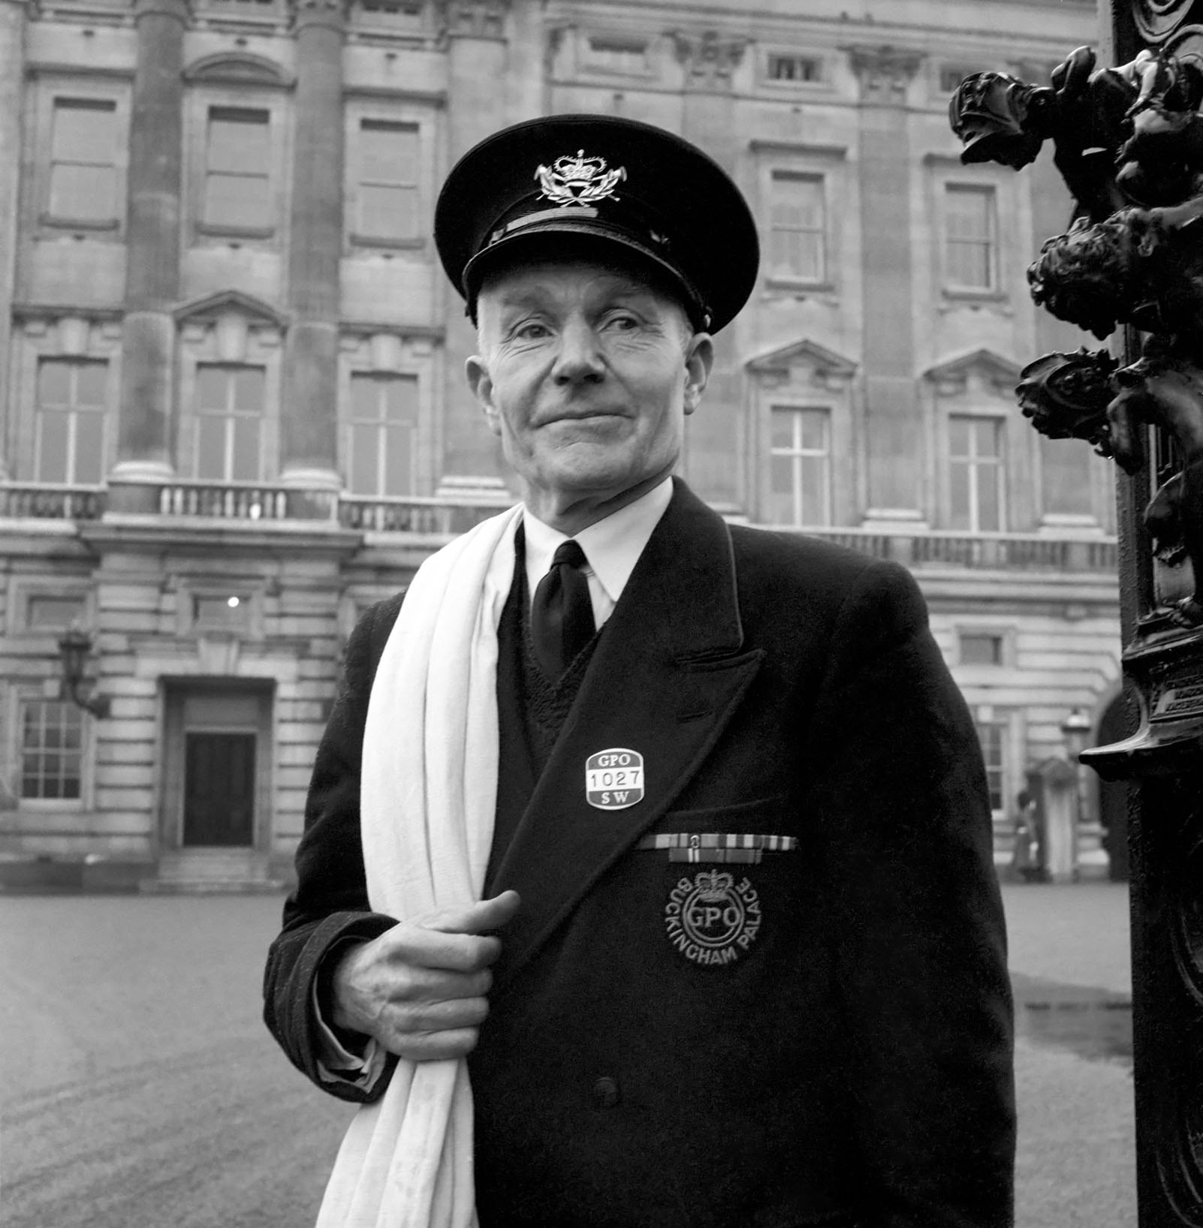
©Trinity Mirror/Mirrorpix/Alamy Stock Photo
Notes:
©Trinity Mirror/Mirrorpix/Alamy Stock Photo
A Royal Postman with his special badge delivers the mail to Buckingham Palace.

Slide 9
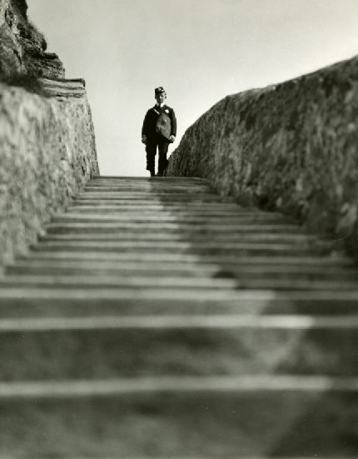
©Royal Mail Group Ltd, courtesy of The Postal Museum POST 118/36
Notes:
©Royal Mail Group Ltd, courtesy of The Postal Museum POST 118/36
A postman descends some stairs at Southstack, Anglesy that lead to a lighthouse. The postman estimated he walked up more than 1.5 million steps in his six years of delivering there.

