Slide 1


Slide 2




The Postal Museum Learning Resource
Terms of Use
By downloading this PowerPoint and using these images you agree to The Postal Museum (TPM) and Royal Mail Group Ltd terms of use.
The material in this PowerPoint is provided for non-commercial and educational use in your classroom.
You can use the presentation or individual images in lessons and activities, and print out the images for use in your classroom.
You can share this presentation with other teachers for non-commercial and educational use in their classrooms.
Image credits must be included wherever the image is used. These are below each image, e.g. ©The Postal Museum 2010-0432/2
Non-The Postal Museum material is included at the agreement of the copyright holder and must also be credited, e.g. ©Courtesy of BT heritage and archives

Slide 3
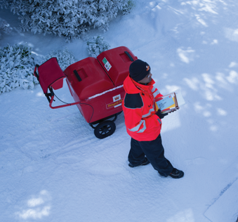
©Royal Mail Group Ltd
Notes:
©Royal Mail Group Ltd
This postie is delivering letters in the snow. He’s wearing a knitted hat, thick gloves and a warm high vis coat.

Slide 4

©Royal Mail Group Ltd
Notes:
©Royal Mail Group Ltd
When the town of Keswick flooded, postie Nim Lockwood used his vehicle to move people to safety.

Slide 5
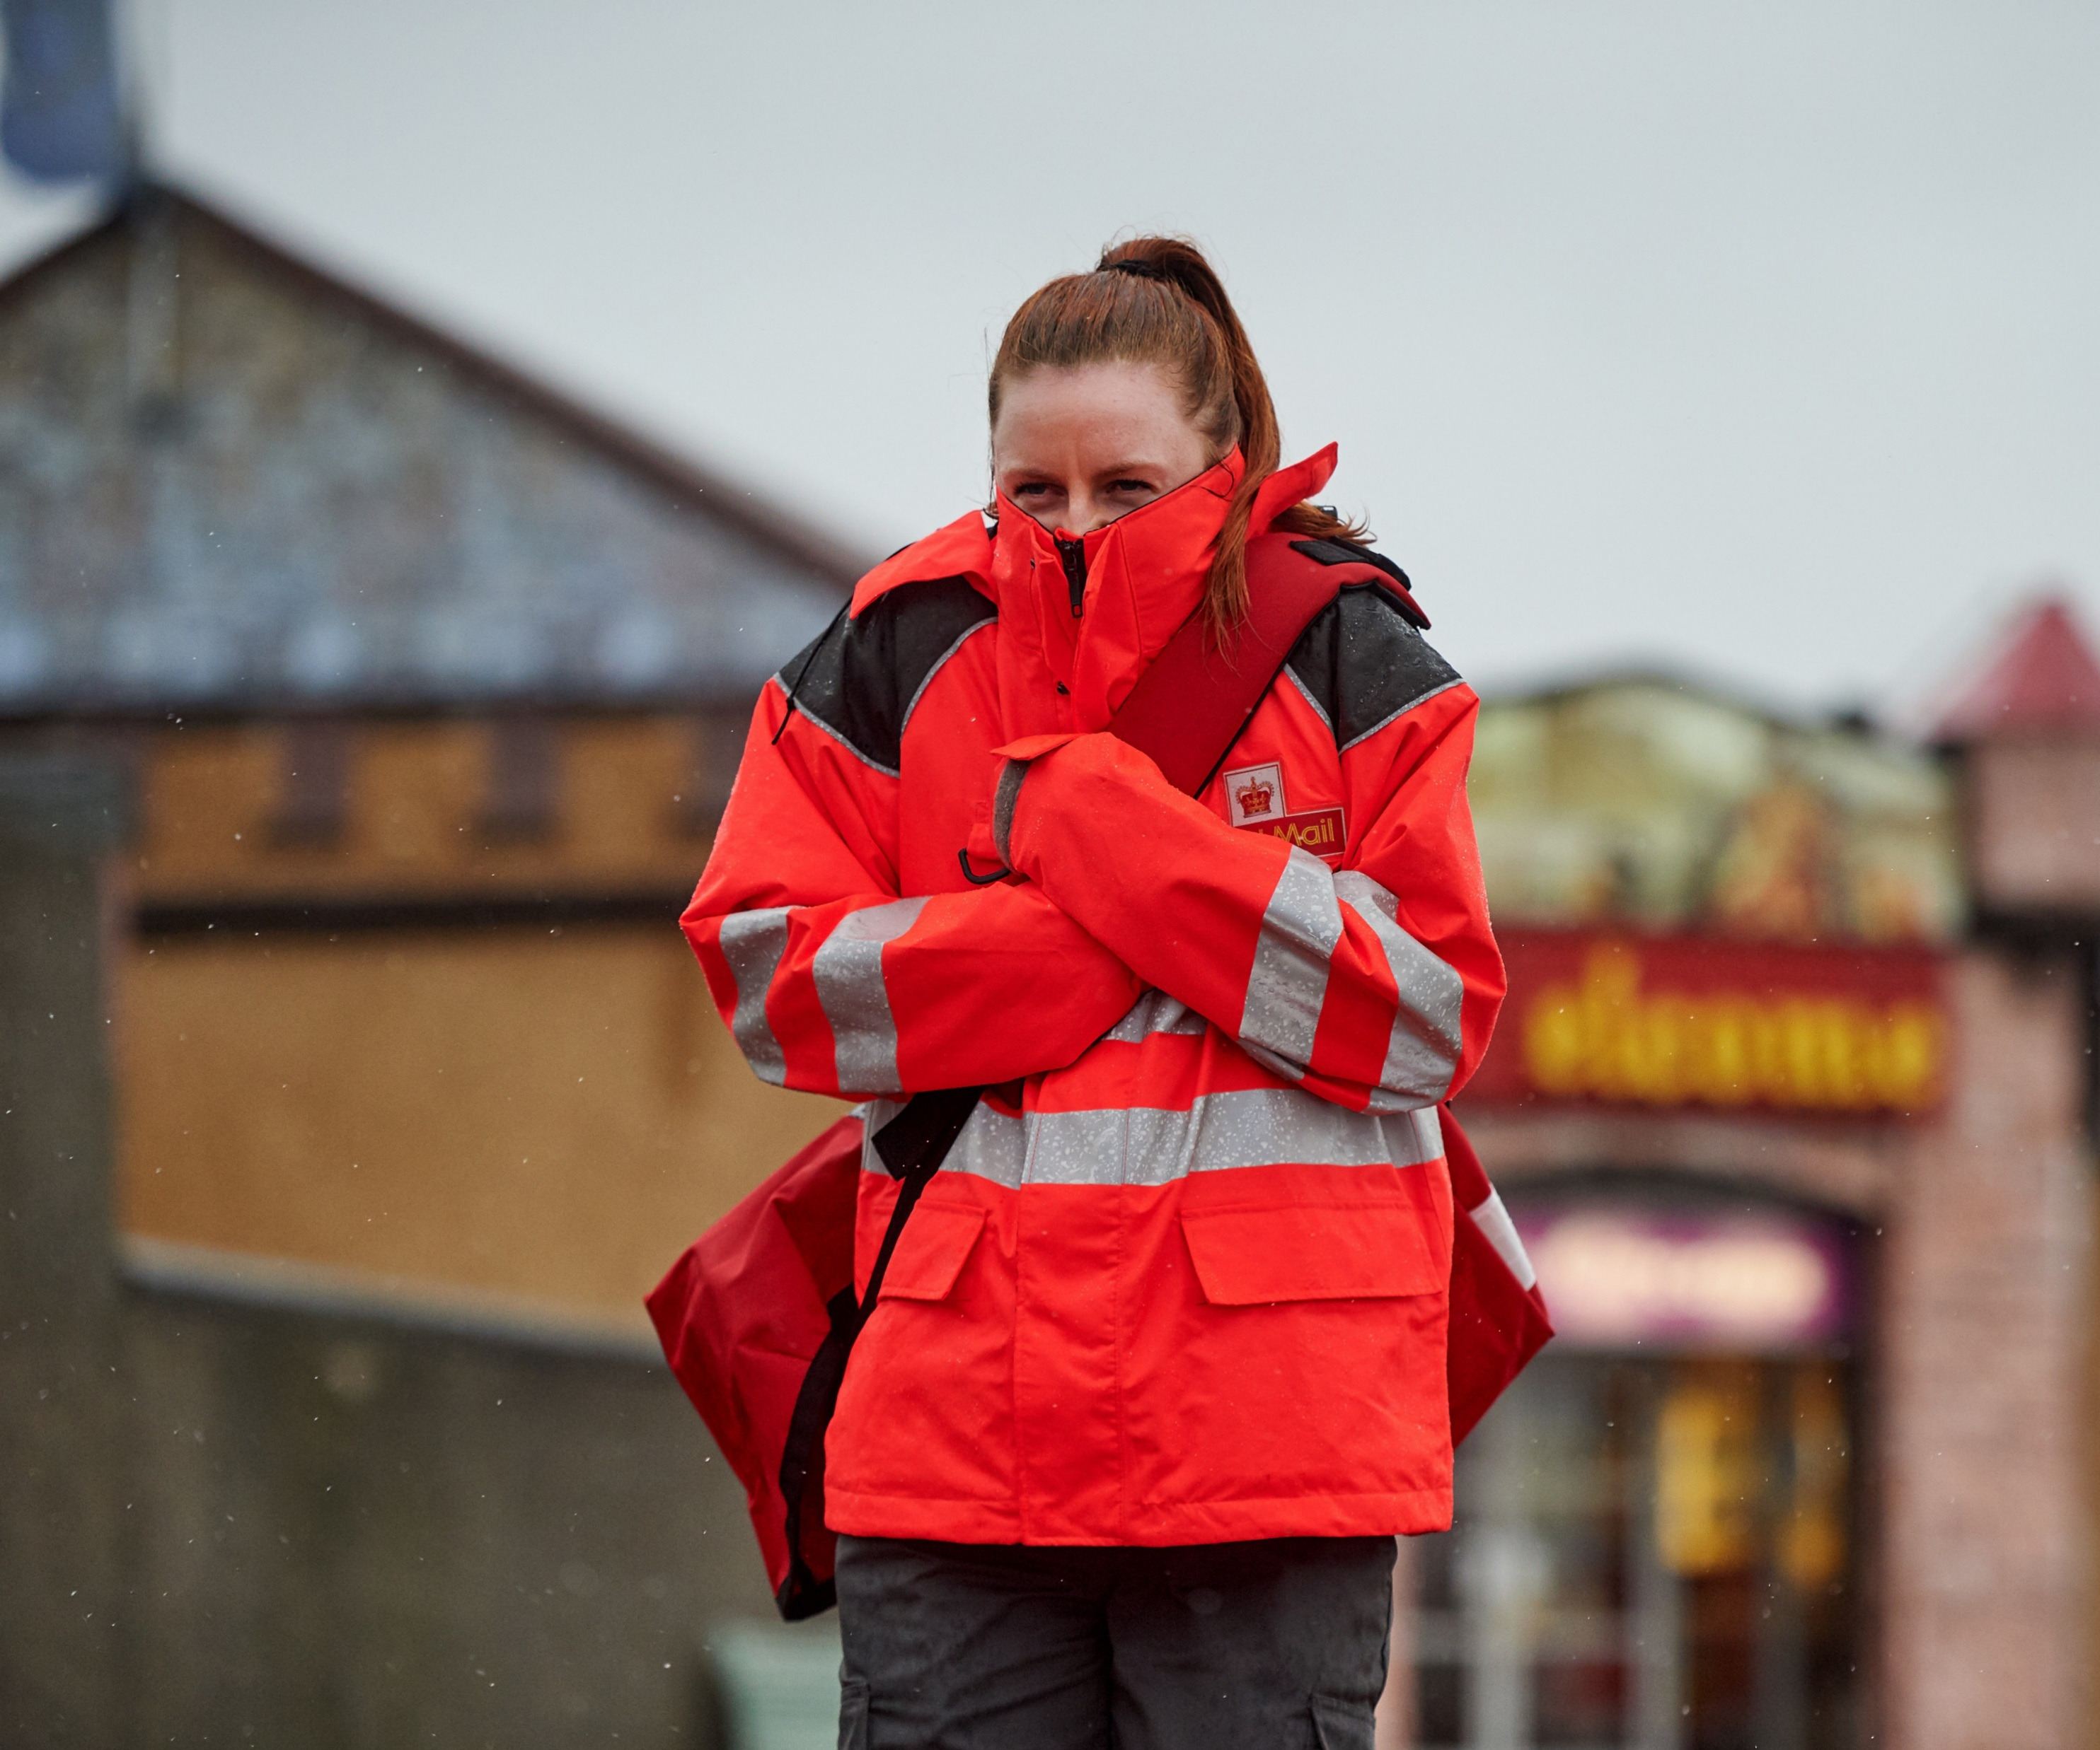
©Royal Mail Group Ltd
Notes:
©Royal Mail Group Ltd
This female postie is wrapped up warm to protect herself from the cold.

Slide 6
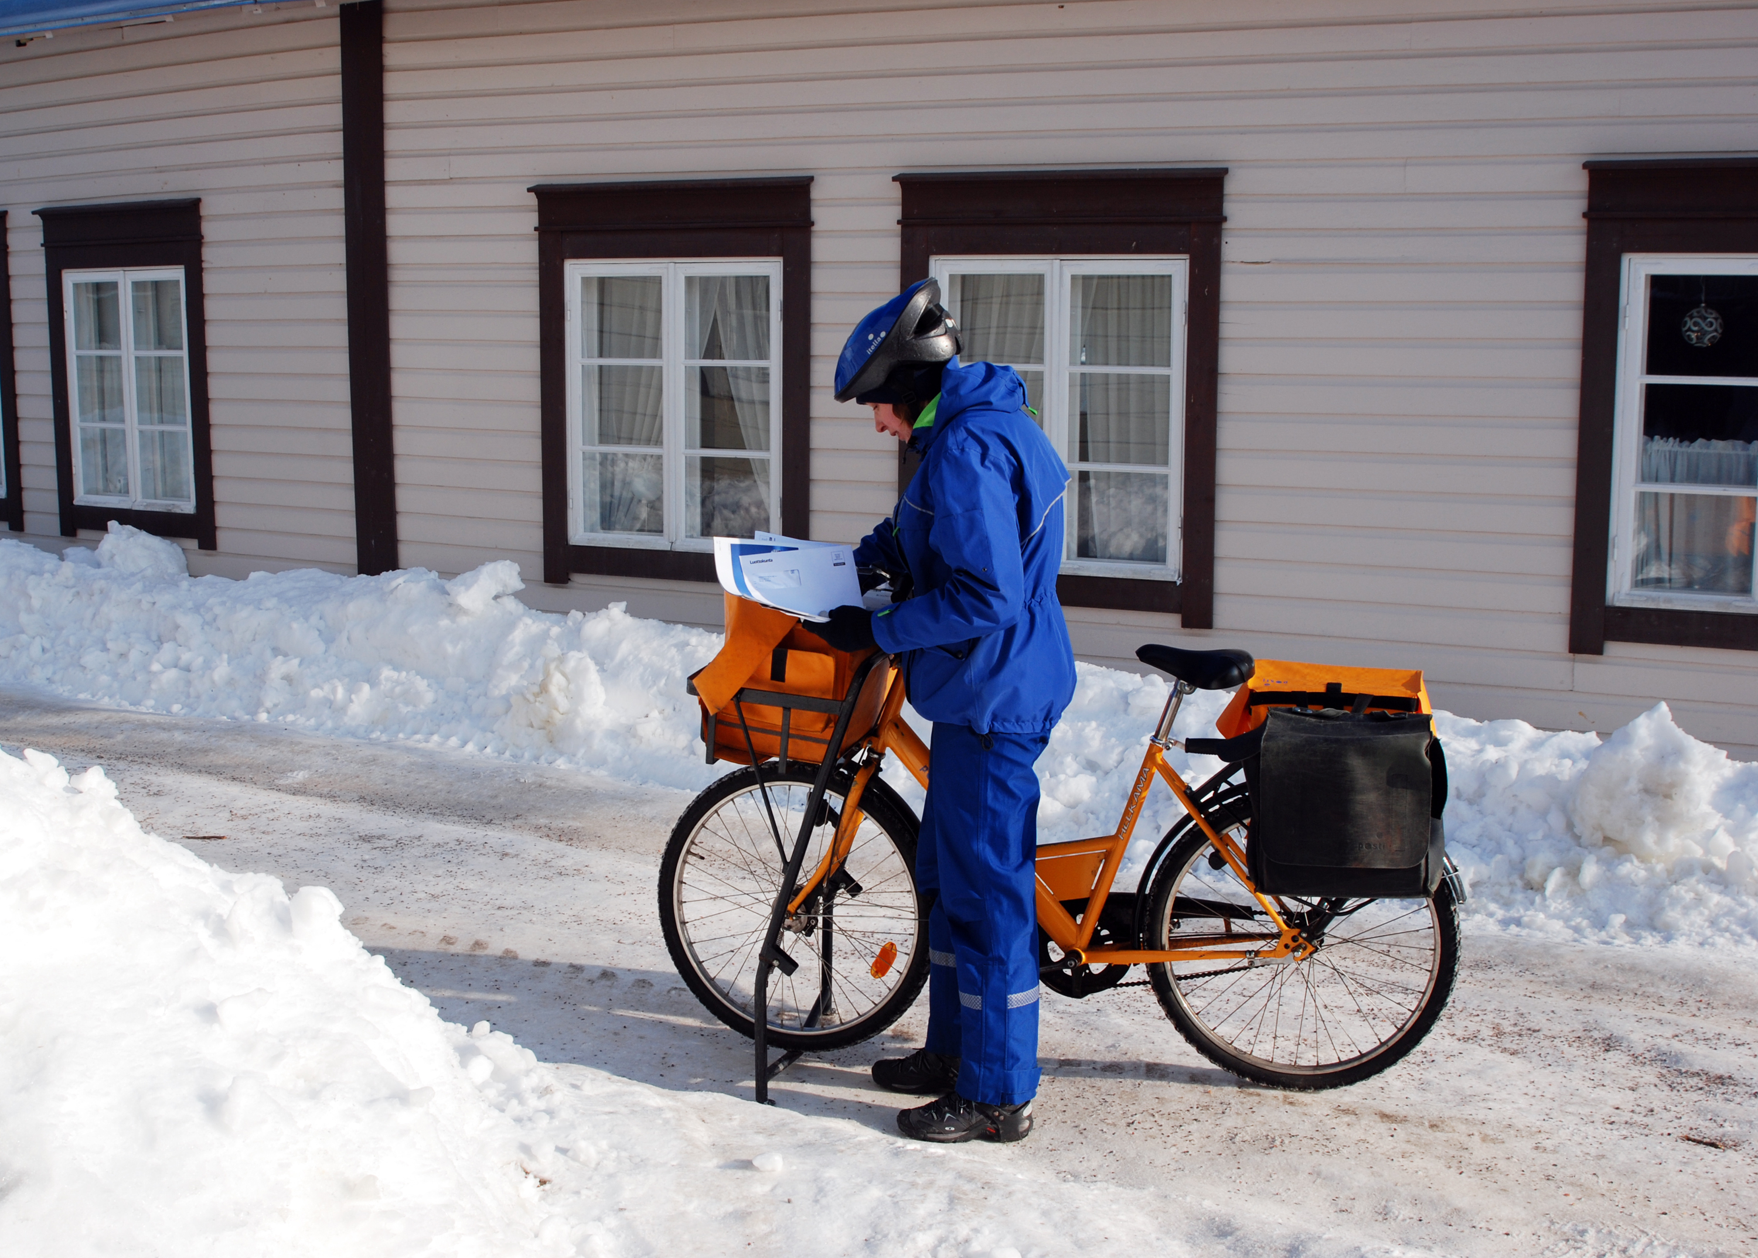
©N. Fransua/Shutterstock.com
Notes:
©N. Fransua/Shutterstock.com
This postie in Finland wears an all-in-one snow suit to stay warm and dry.

Slide 7
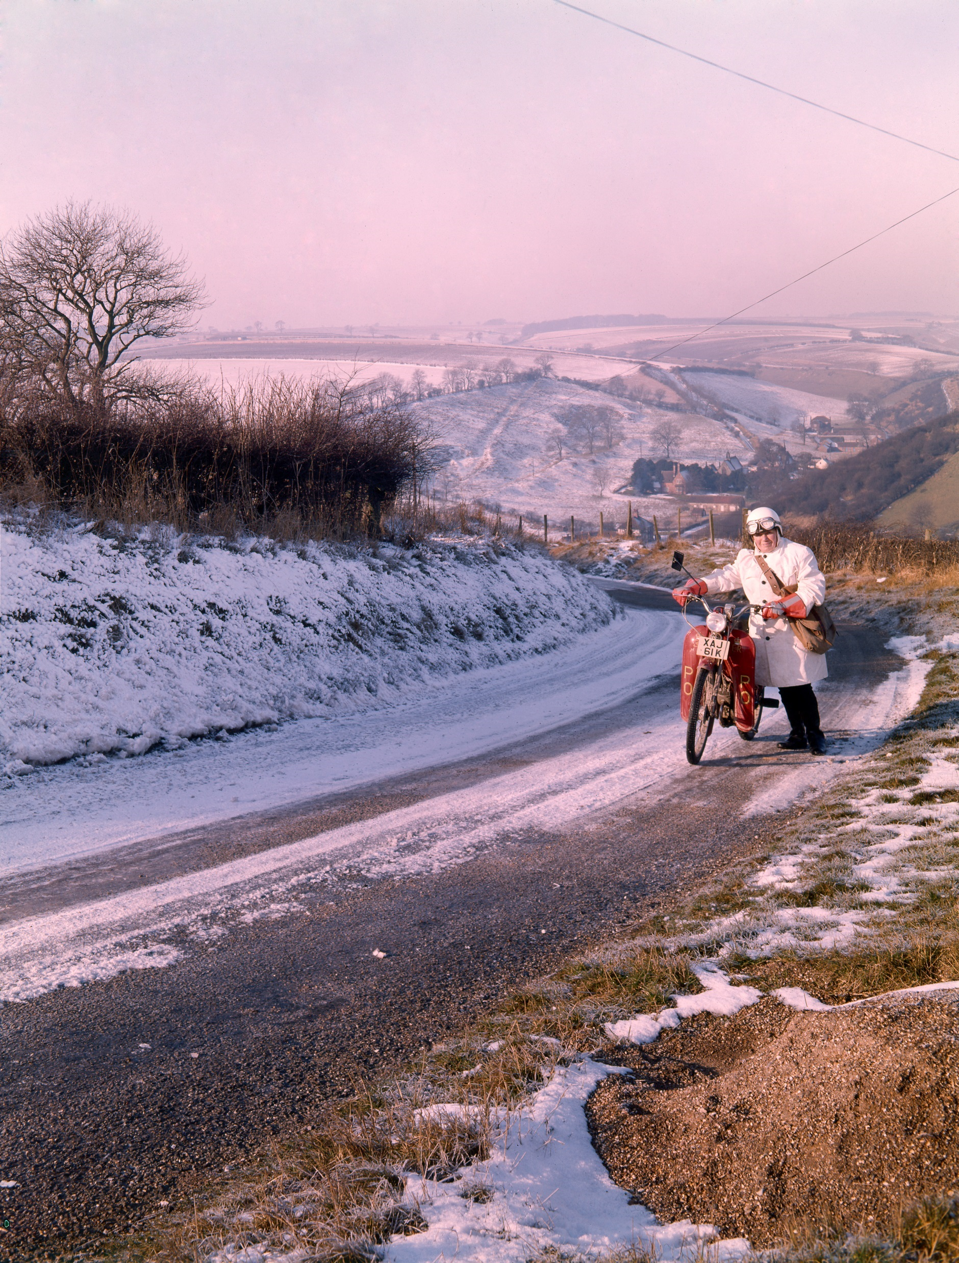
©Royal Mail Group Ltd
Notes:
©Royal Mail Group Ltd
A postwoman pushes her motorcycle up the hill in heavy snow in rural Yorkshire in the 1970s.

Slide 8
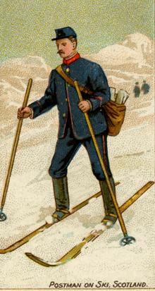
©The Postal Museum
Notes:
©The Postal Museum
This illustration shows a postie skiing in rural Scotland in the early 20th century.

