Slide 1
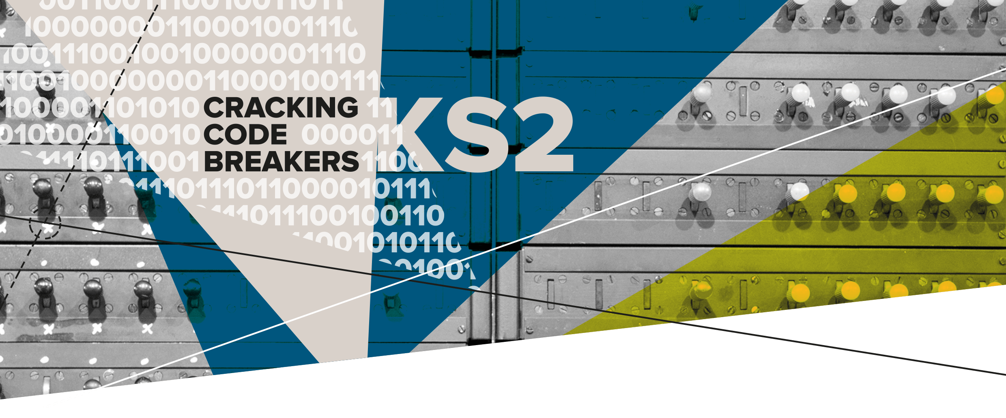

06 – Digital Security
Key words:
Secure | Password | Character

Slide 2
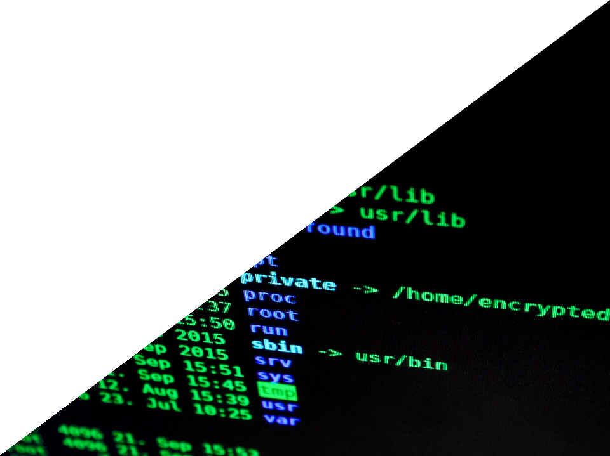
Keeping information secret
Modern technology makes it more important than ever to protect our communications.
People may try to steal personal information and money through a process called hacking.
Hacking is when someone breaks into a computer system.

Slide 3
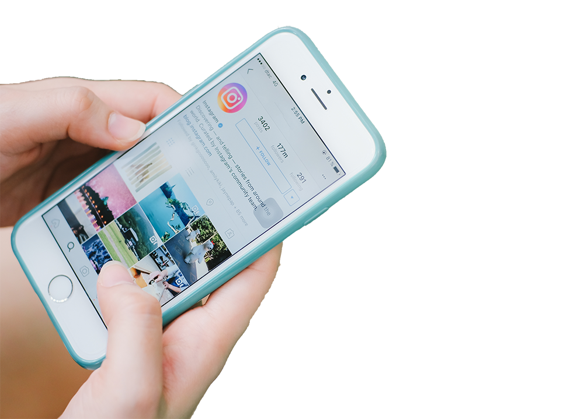

Key word: Secure
Secure means to remain safe and protected.
Staying secure online means we need to protect our identity and accounts so that other people can not get access to them.
We can use strong passwords to improve security.

Slide 4
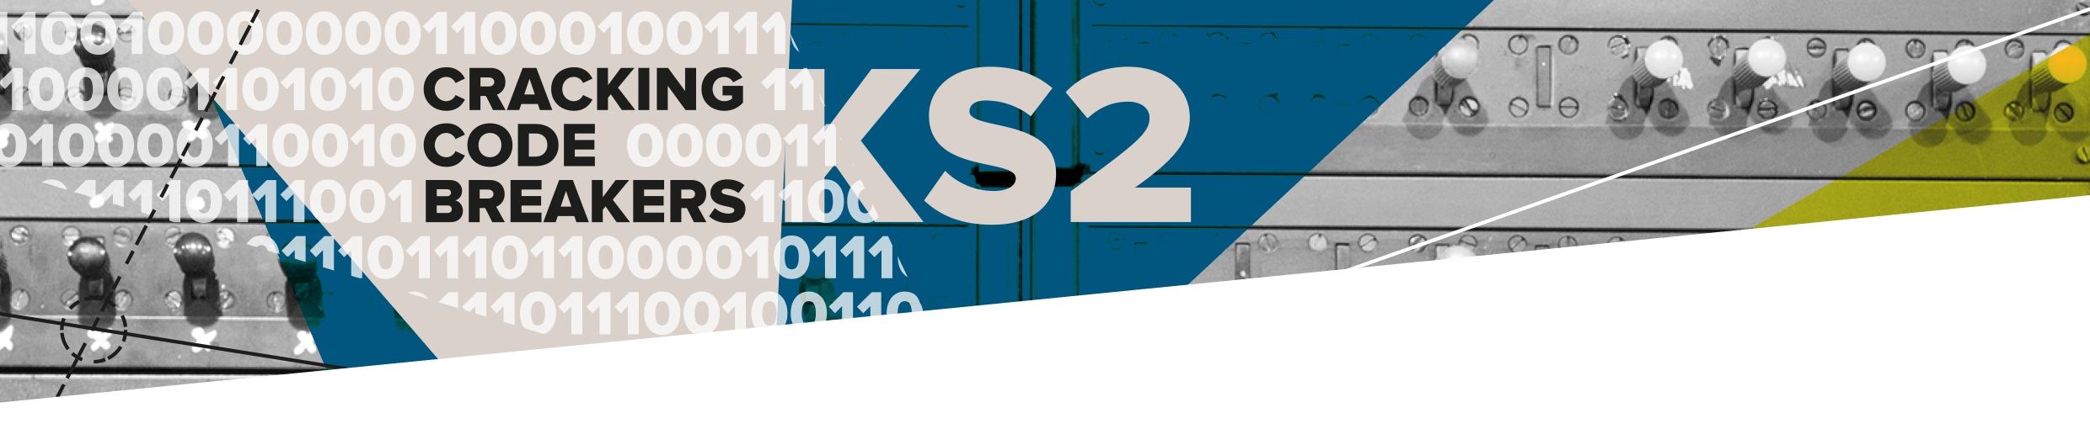
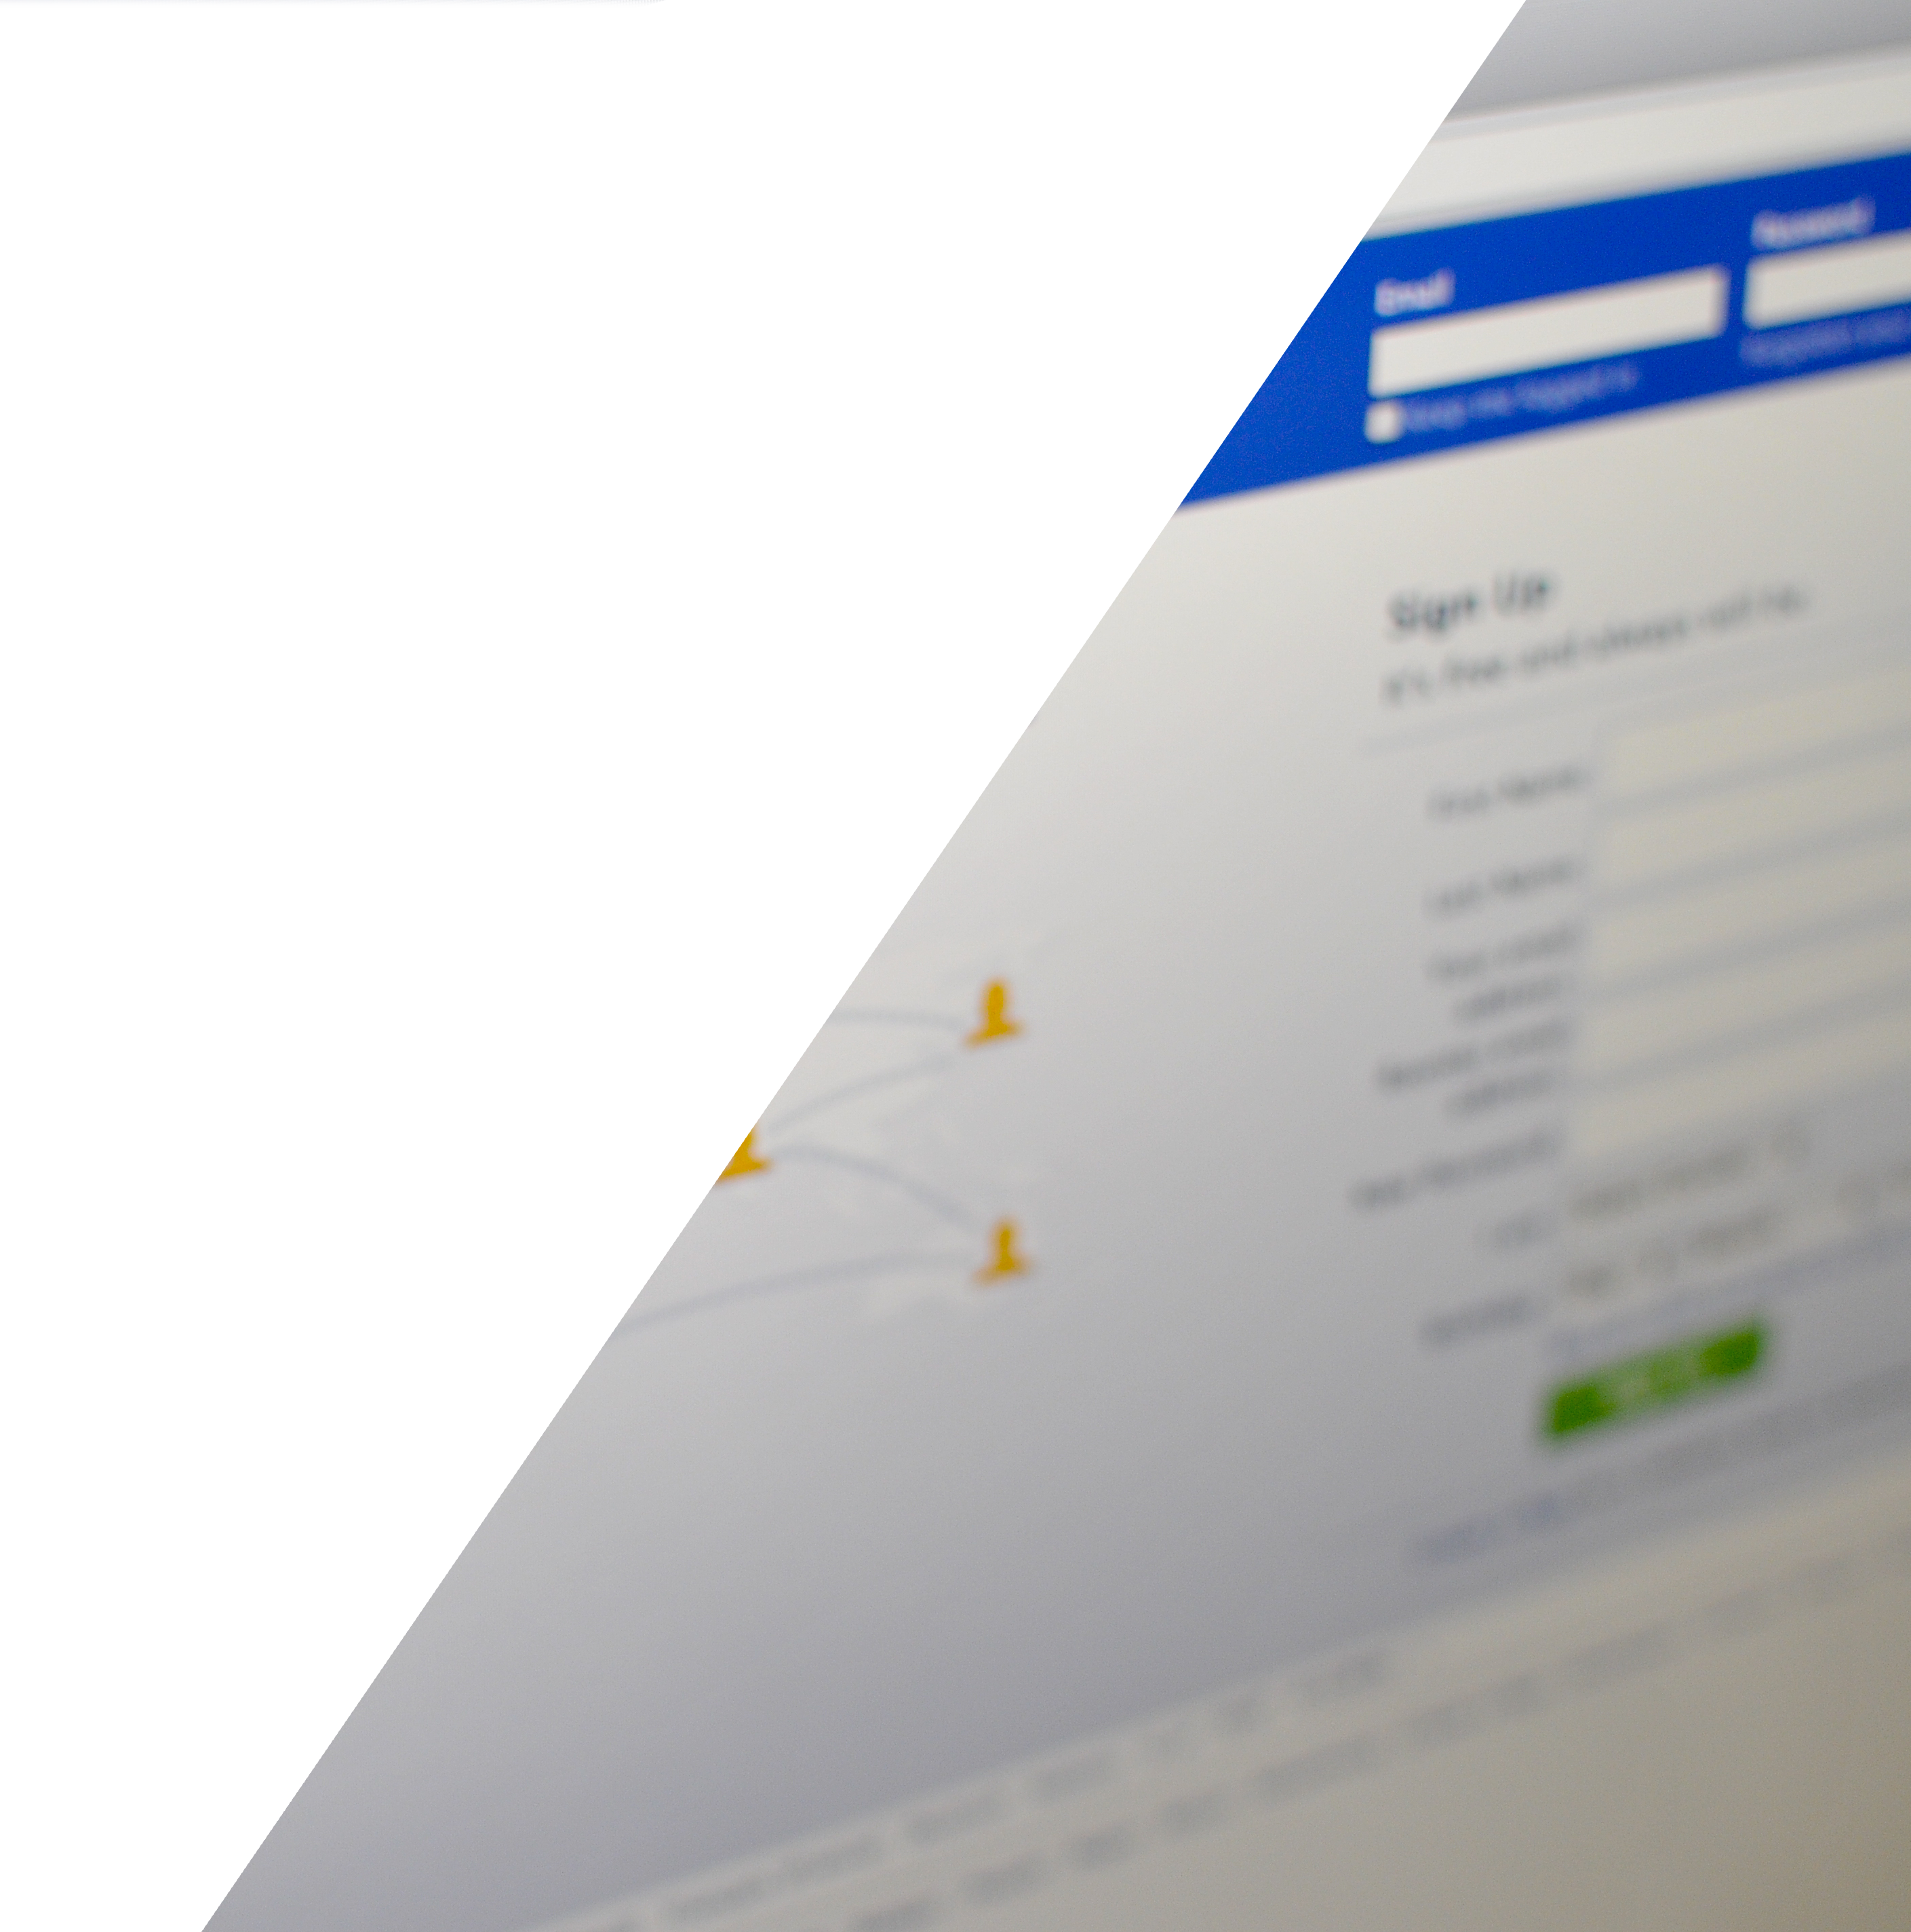
Key word: Password
A password is set of letters, numbers or symbols which we use to gain access to a resource.
The longer the password the harder it is to break.
It should not contain personal information that is easy to guess!
Notes:
Teachers’ Notes:
Do not share your passwords with anyone.
Personal information would be things like date of birth or name.

Slide 5
Key word: Characters
Characters are Letters, numbers or symbols like $ @ ? or “.
To make a password more secure you should use a mixture of characters.
Aim to make your passwords 12 characters long.
Make up a rule to help you remember the characters in your password.
Rule: Film animal holiday Password: Trolls&dogs2Cornwall

Slide 6
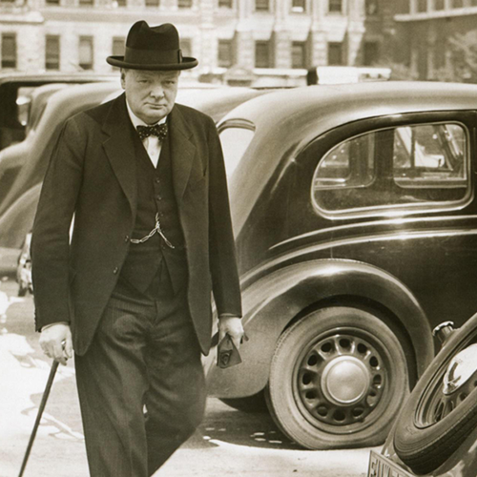
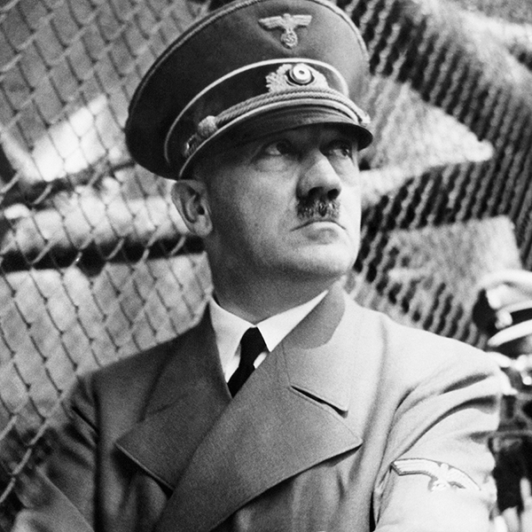
Password challenge
Let’s find out how easy it is to guess a password if it contains obvious information.
Notes:
Teachers’ Notes:
Good passwords are ones that are hard for someone else to guess.
Never use personal information in a password.
Think up a rule to help you to remember.

